Slide 1
Company Presentation

Slide 2
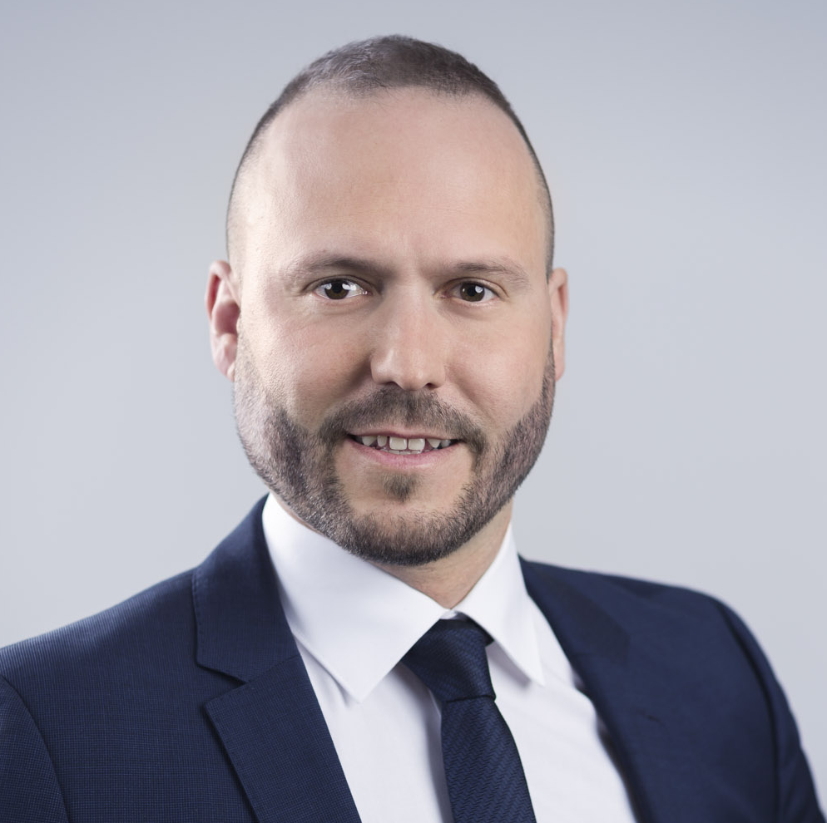
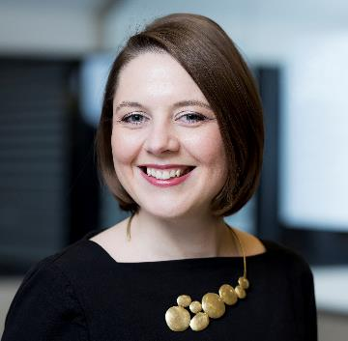

GIG Karasek – Who we are
Globally acting, Austrian supplier of thermal separation and environmental technology
Our offering
Core competence: Design and manufacturing of falling-film, thin-film, short-path, distillation and drying technology
Technology for CO₂ valorization and industrial heat pump solution
Projects ranging from pilot plants and skid units to turnkey plants on EPC basis
Own technical center for trials and R&D
Our motto
“Concentrating the Essentials” perfectly fits to our approach and way of working. We are focusing on utmost efficiency – both, in our core competences but also in new environmental technologies.”
Andreas Schnitzhofer, General Manager
We are proud on our
extensive knowhow, top-quality technology and highly committed employees. We have everything in our hands for supporting our customers and being a valued industry partner.”
Julia Aichhorn, General Manager

Slide 3
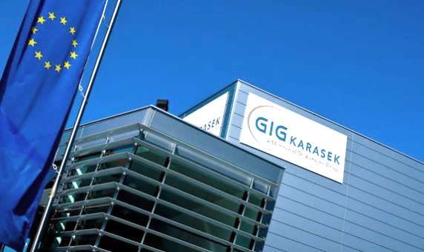
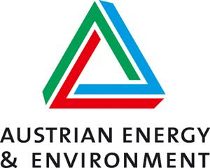
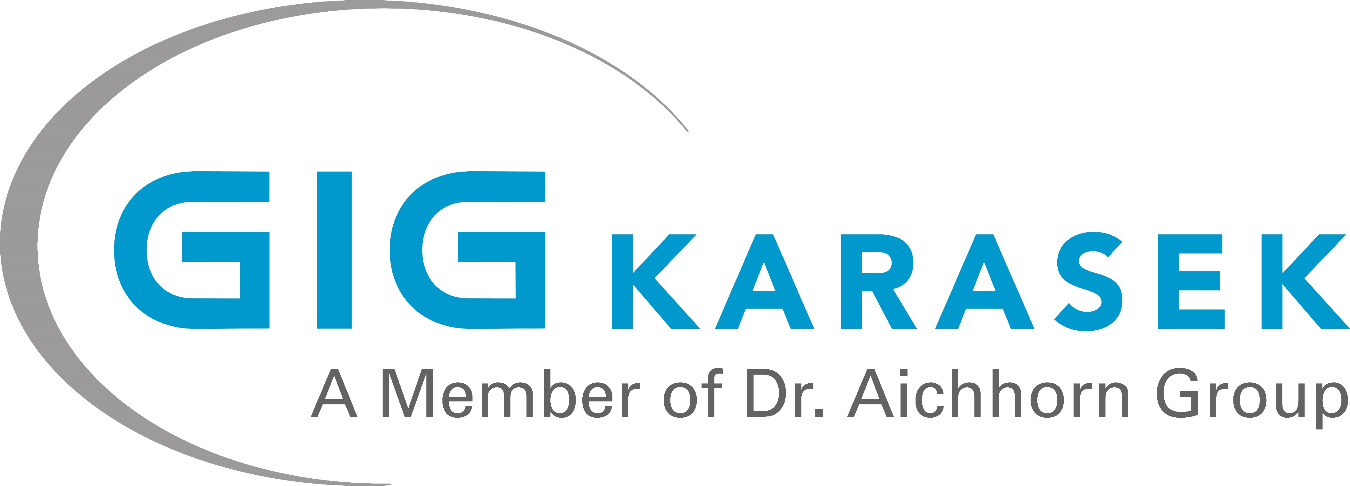
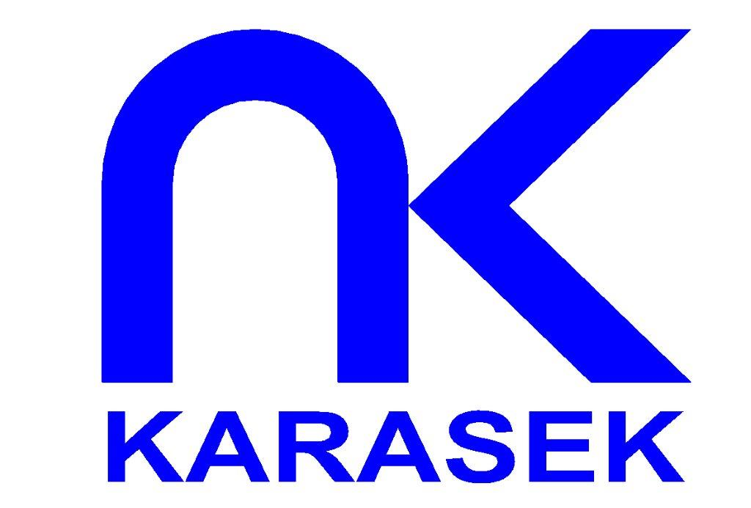
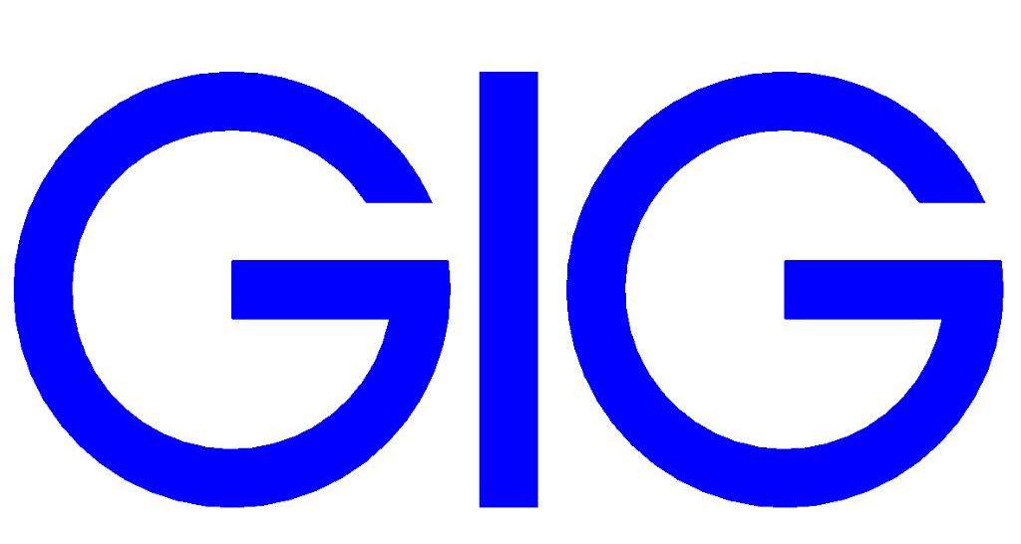
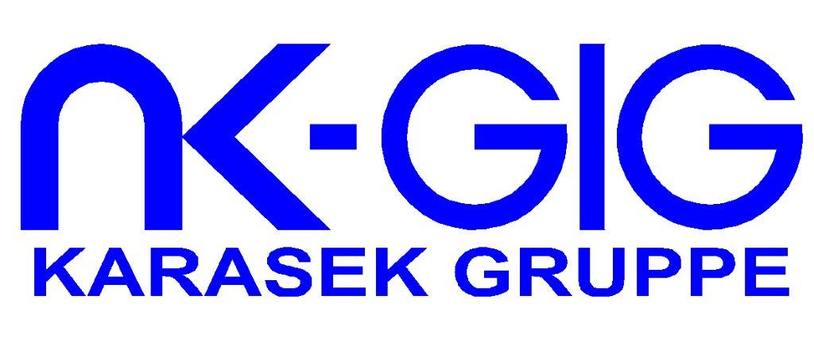
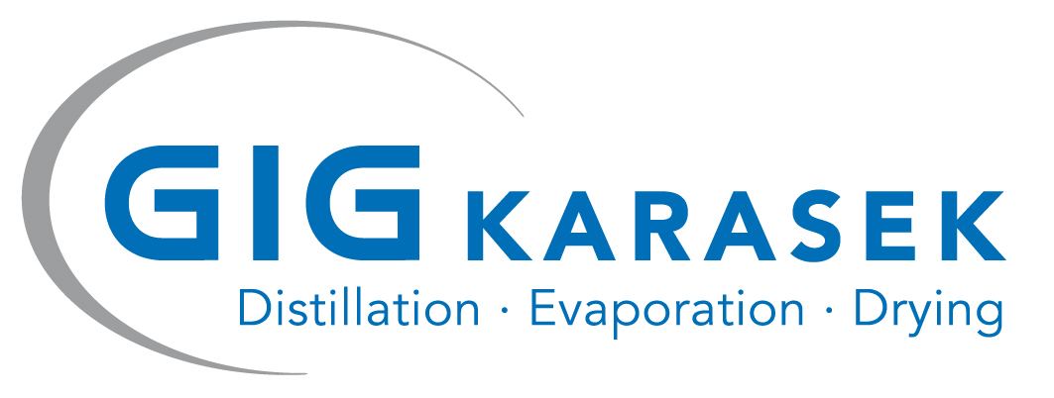
History and milestones
Franz Karasek opens a metal workshop
Acquisition of Austrian Energy & Environment,
plate type evaporator
production plant
GIG Karasek becomes part of Dr. Aichhorn Group
Opening of Technical Center
1933
1998
2004
2008
2022
1996
2016
Acquisition of
Grill & Grossmann
Formation of Karasek Group
Merger of GIG and Karasek to GIG Karasek and rebranding
New business unit Environmental Technologies with focus on CO₂ valorization

Slide 4
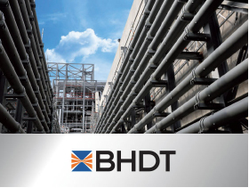
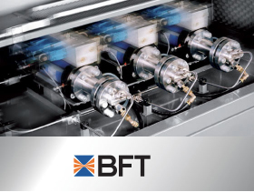
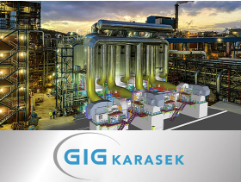

Dr. Aichhorn group
Worldwide manufacturer and provider of high-pressure equipment and high-pressure components for the chemical and petrochemical industries
European producer of
high-pressure pumps
with operating pressures between 200 and
1,200 Mpa
Globally acting, Austrian supplier of thermal separation and environmental technology
The Dr. Aichhorn Forestry Estate is sustainably managed according to the latest forestry knowledge available

Slide 5
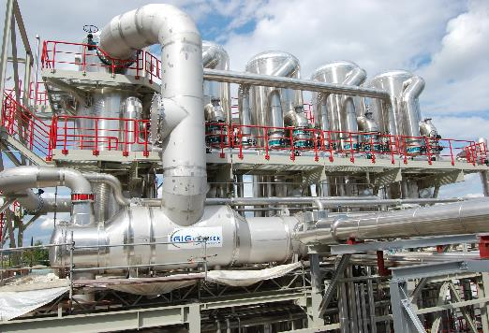
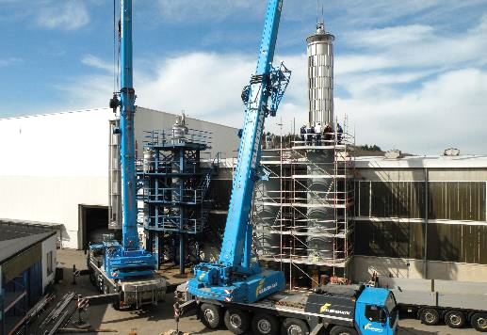
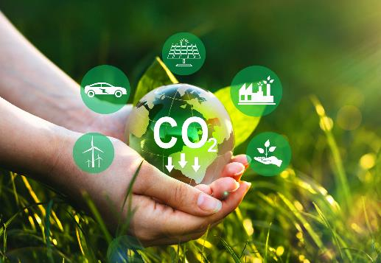
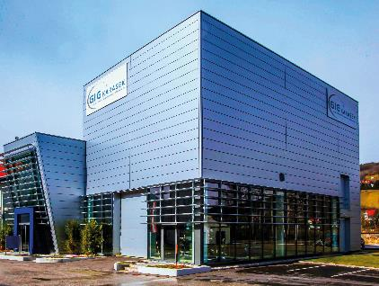
GIG Karasek – Our business units
Conventional Evaporation Technology
Different types of evaporators and tailor-made process solutions for
high evaporation rates
Thin-film and Short-path Technology
Different types of evaporators for complex tasks and tailored process solutions
Environmental Technologies
CO₂ valorization and industrial heat pump technology for a sustainable economy
Technical Center
Laboratory tests, pilot test and scale up concepts for thermal separation and environmental technologies

Slide 6








Key facts and figures
~ 30 € MIO. ORDER INCOME
Average during
the past 10 years
125
EMPLOYEES
+ temporary workers depending on workload
NUMEROUS successfully completed PROJECTS
on a global scale
GLOBALLY REPRESENTED
by international partners and representatives
Own WORKSHOPS
in Austria, plus a global network of qualified
sub suppliers
Own TECHNICAL CENTER
for testing, scale up and R&D
CERTIFICATES AND APPROVALS
ISO 9001, EN ISO 45001
PED, AD 2000, ASME, SQL (China)
Comprehensive SERVICE CAPABILITIES
Spare parts, IIoT solutions, financing

Slide 7
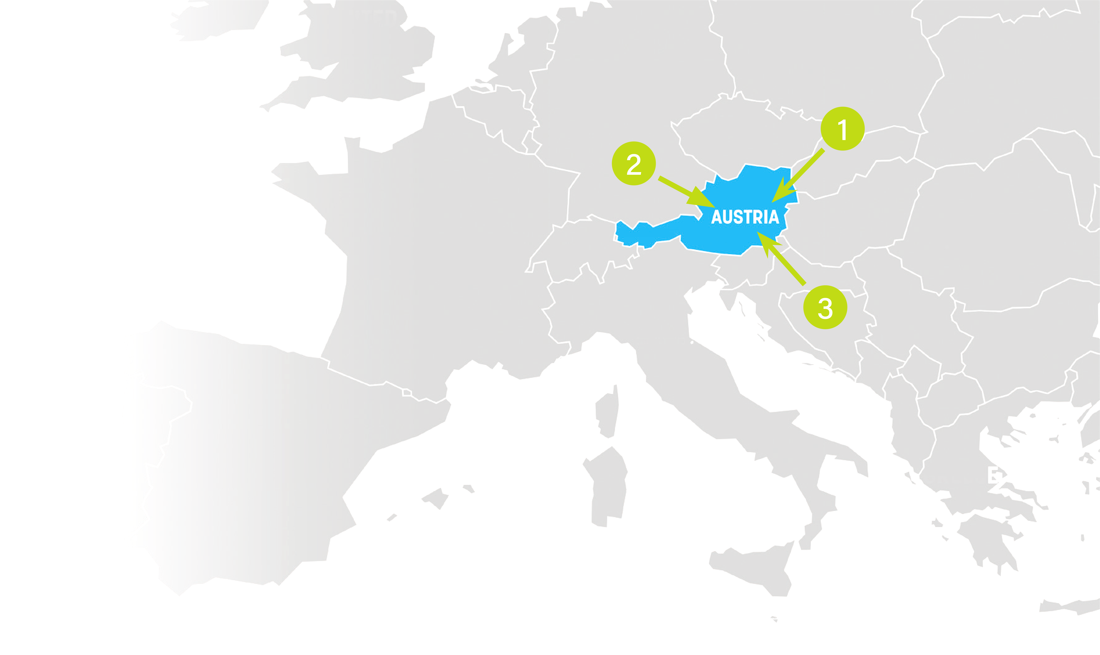

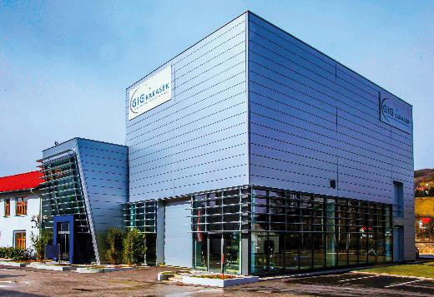
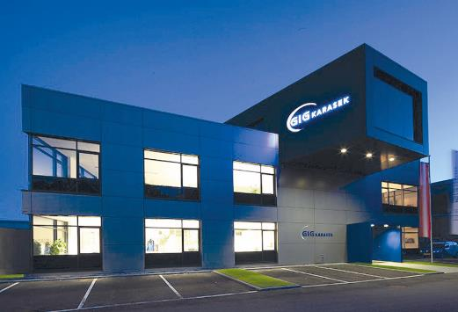
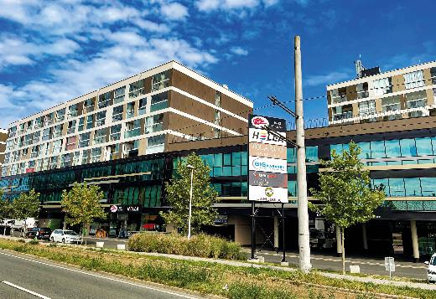
Our locations in Austria
1
2
3
Gloggnitz-Stuppach
2640 Neusiedlerstraße 15-19
Headquarters, manufacturing for conventional evaporation technology, technical center
Attnang-Puchheim
4800, Industriestraße 21
Engineering and manufacturing for the areas thin-film, short-path and CO₂ valorization technology
Graz
8055, Brauquartier 21, 1 OG., Top 9
Process- & plant engineering for conventional evaporation and industrial heat pump technology

Slide 8

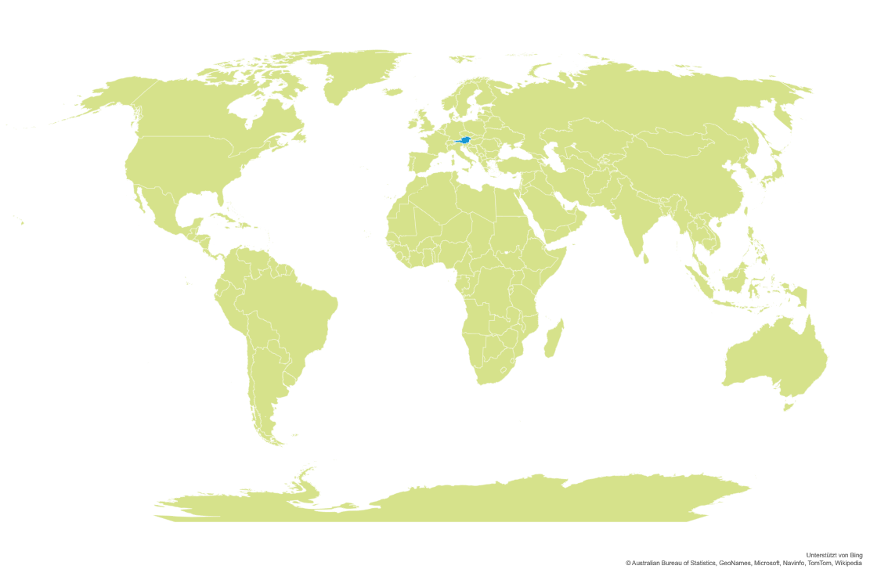
International representations
7
T. Miettinen
Finland
7
Banmark
Finland
6
7
2
6
2
Banmark
Sweden
14
A J Tyzack & Co
United Kingdom, Ireland
3
Rieckermann South Korea
1
14
1
3
4
13
13
IPS LLC
United States
A2E Industrie
France
ERUN Information & Technology
China
9
12
4
10
C. Salpeter
Switzerland
11
9
BFT FZCO
Middle East
13
Dr. Aichhorn Group (China)
China
GLOBALLY REPRESENTED
by international partners and representatives
8
UDEC
South Africa
12
5
Rieckermann Taiwan
5
8
11
P. Gutt Representações
Brazil
Rieckermann Thailand, Indonesia, Malaysia, Singapore
10
Rieckermann
India

Slide 9
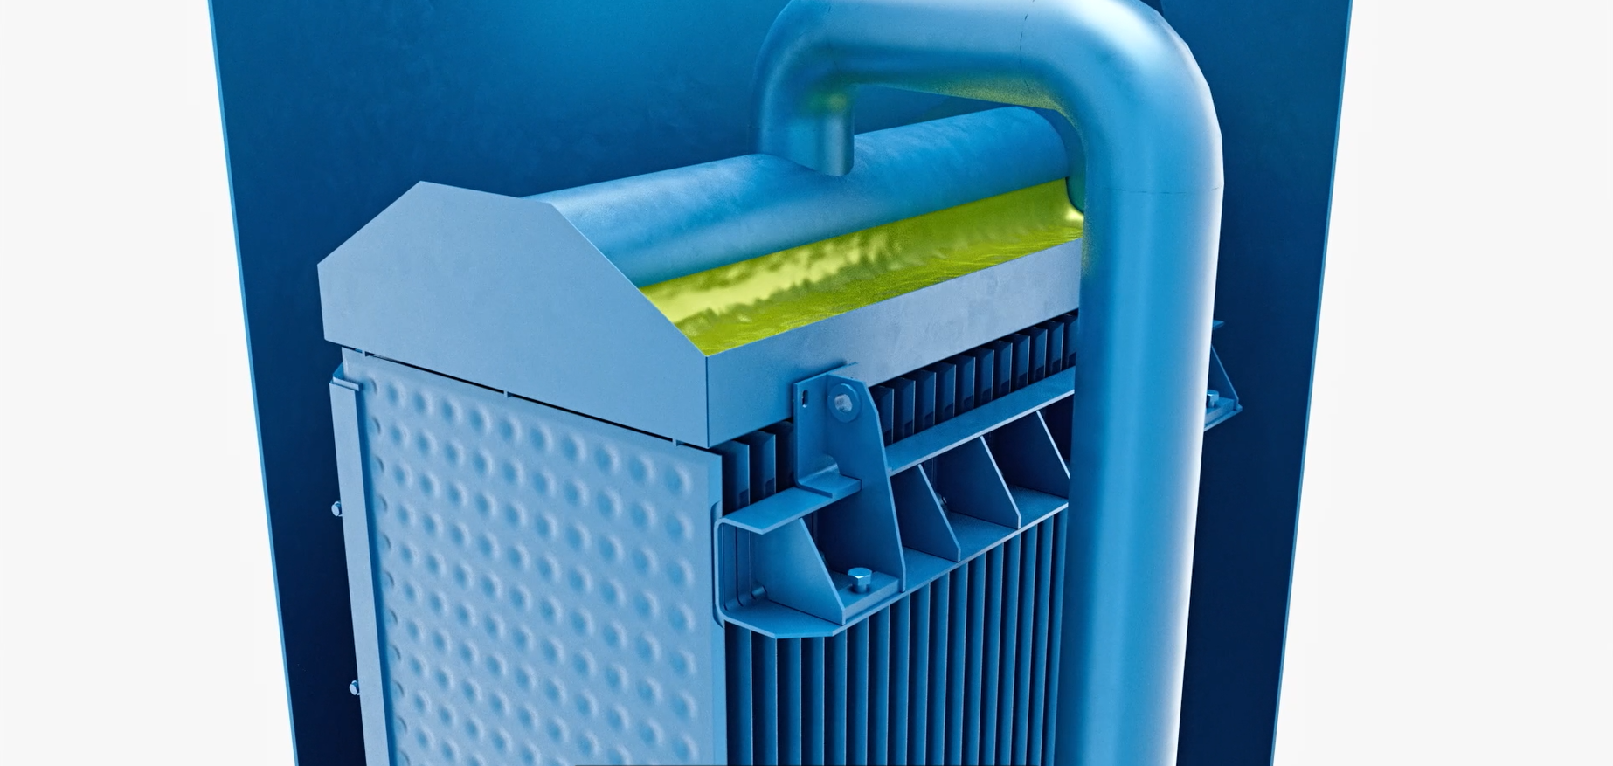

Conventional evaporation technology
Suitable for low-viscous and
non-sensitive substances
Conventional evaporator types:
  Plate falling-film evaporator
  Tube falling-film evaporator
Rectification / distillation systems
Energy optimized systems
  Multiple Effect Evaporation
  MVR (Mechanical Vapor Recompression)
  TVR (Thermal Vapor Recompression)
SEE
VIDEO
TYPICAL KEY PARAMETERS
Feed | approx. 1 t/h to > 1000 t/h
Viscosity | up to approx. 250 mPaּ•s

Slide 10

Conventional Evaporation Technology
LACTIC ACID
STARCH
PROCESSES
SOLVENT
RECOVERY
LYOCELL
KRAFT PULP PROCESS
SULFITE PULP PROCESS
BIOREFINERY
(BIOLOGICAL) WASTEWATER

Slide 11
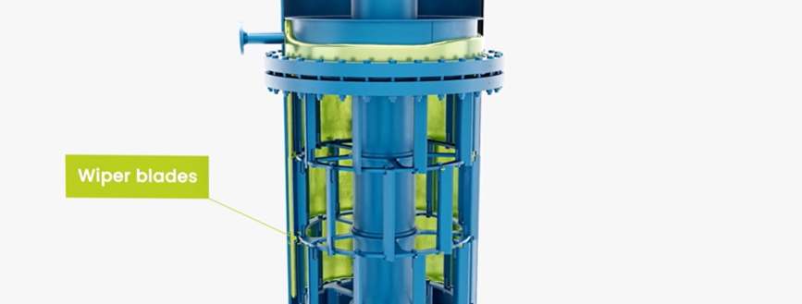

Thin-film and short-path Technology
For high-viscous and sensitive applications
Thin-film evaporator
Thin-film dryer
  Horizontal
  Vertical
Viscofilm evaporator
Short-path evaporator
Miniplant
SEE
VIDEO
KEY PARAMETERS
Feed | approx. 10 kg/h to 20.000 kg/h approx. 10 kg/h to 50 kg/h (Miniplant)
Temperature | up to approx. 390°C
Min. operating pressure | approx. 0,001 mbara
Viscosity | < 5.000 Paּ•s (Viscofilm)

Slide 12
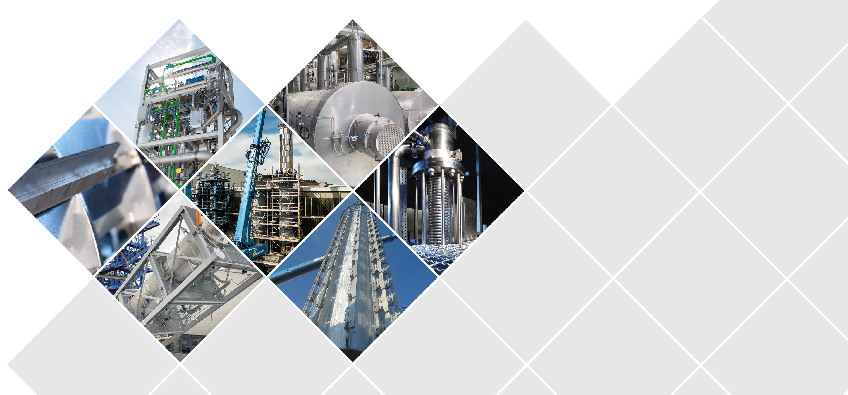
Thin-film and short-path Technology
USED OIL
BASIC
CHEMICALS
LECITHIN
HIGH-VISCOUS MEDIAS
TALL OIL
MUNICIPAL & INDUSTRIAL
SLUDGE
SILICONE OIL
ISOCYANATE
EPOXY
BIODIESEL
GLYCERINE
LACTIC ACID

Slide 13
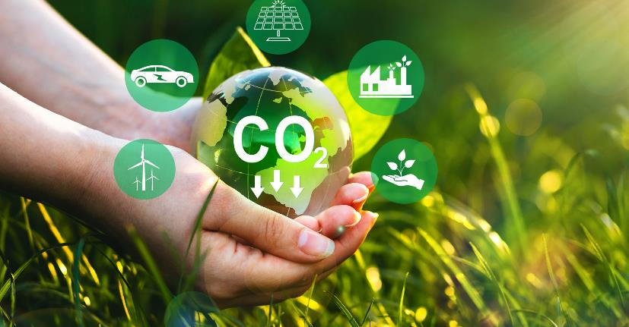

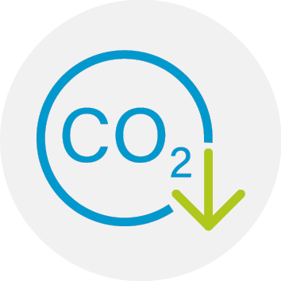
CO₂ valorization
SEE
VIDEO
CO₂ emissions released by burning of fossil fuels contribute significantly to greenhouse effect and global climate change
We have set ourselves the task to contribute to the worldwide efforts of Carbon Capture, Utilization and Storage (CCUS)
New business unit for carbon utilization
formed in 2022
Focus: Electrochemical transformation of CO₂ in valuable chemicals and fuels
Perfectly suited for carbon-intensive industries
Our milestones
Patented CO₂ electrolysis cell
Demonstration of viability on a pilot scale
Ongoing: development to industrial-scale

Slide 14
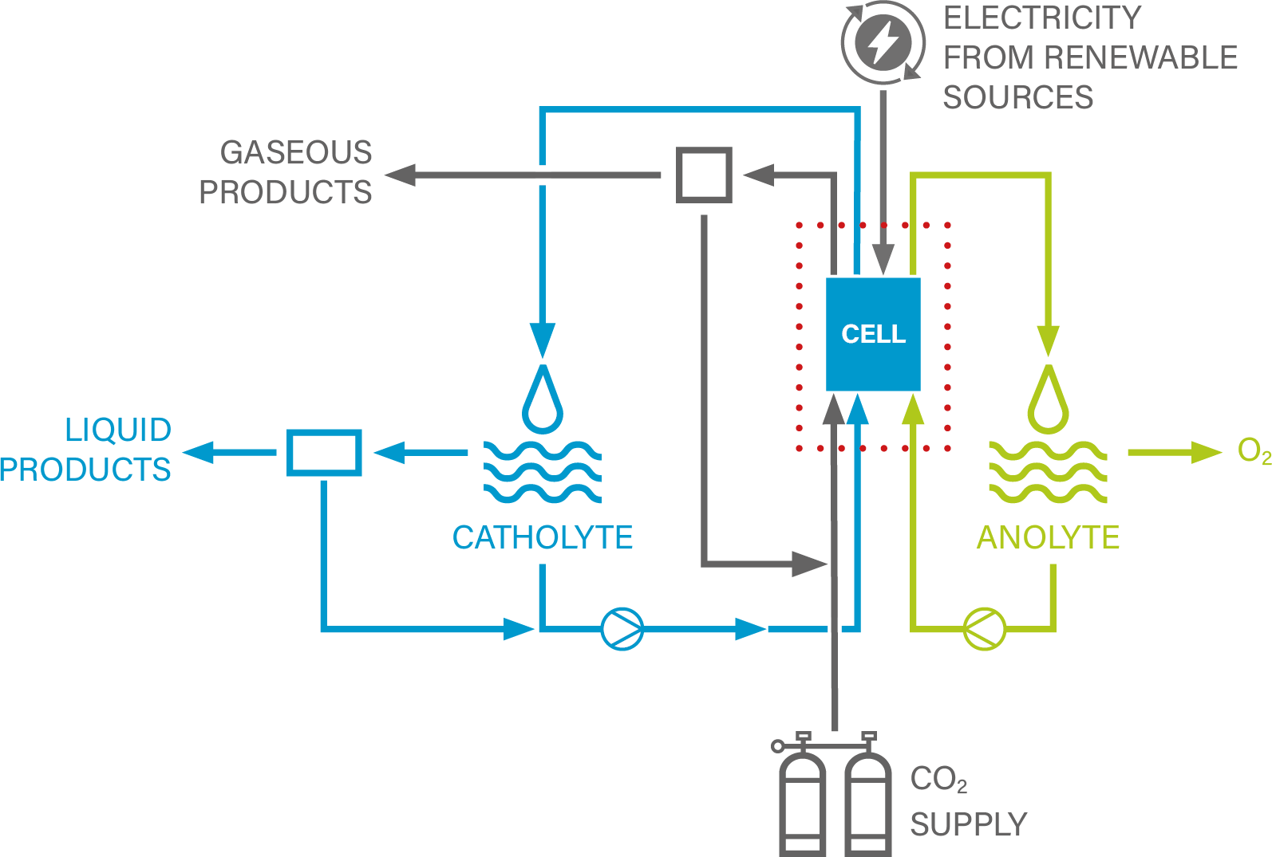
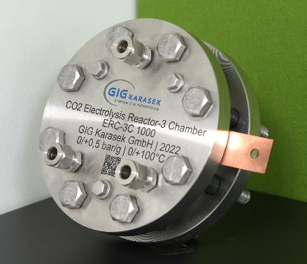
CO₂ valorization
FUNCTIONAL PRINCIPLE
System uses CO₂, water and electricity for production of different carbon compounds
ADVANTAGES
Product diversity: production of a
wide range of valuable products
Zero-emissions thanks to combination of
water and electricity from renewable sources
Scalable to customer demand
Mild process conditions
No hydrogen for process needed
POSSIBLE
END PRODUCTS
Synthesis gas
Ethylene
Formic acid
Methanol
Further chemicals
and fuels on request

Slide 15
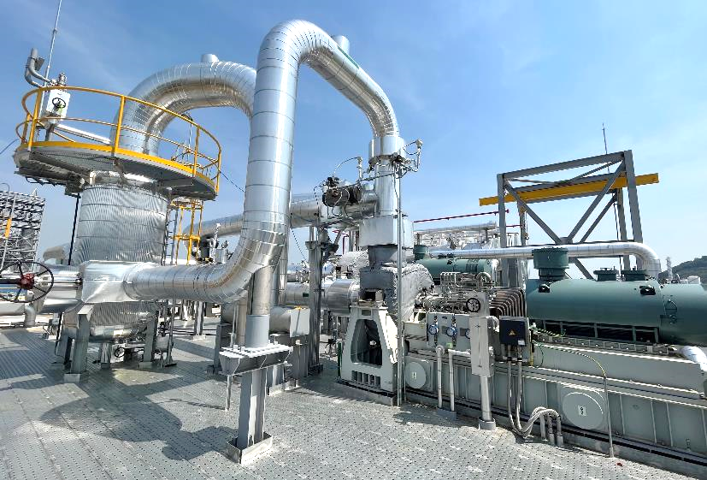
Industrial heat Pump Solution
For sustainable industry processes:
Reduction of primary energy demand and operating costs by waste heat utilization
Our solution: Industrial heat pump system
for recovery and reuse of vapor
FUNCTIONAL PRINCIPLE
Possible input: waste steam or liquid
Energy level of steam is raised by means of
MVR (Mechanical Vapor Recompression) fan(s)
© Piller

Slide 16
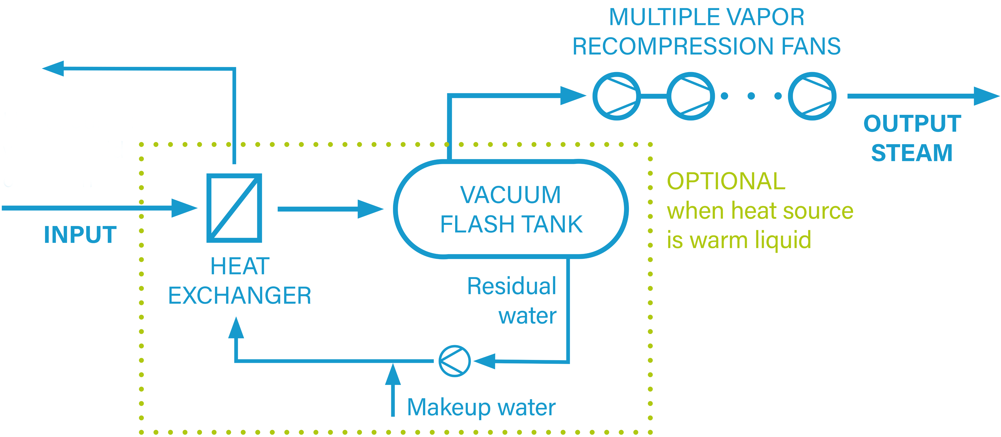
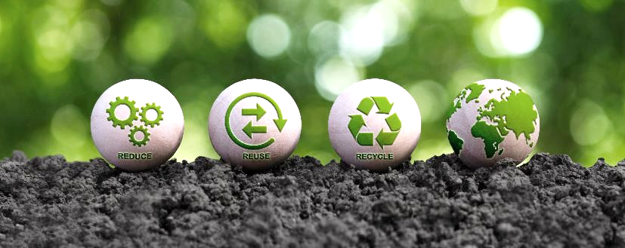
Industrial heat Pump Solution
ADVANTAGES
Reuse waste heat → significant reduction of
CO₂ emissions possible
Economic use of resources → less fresh steam and cooling water demand
High potential of OPEX savings
Straightforward and fast (retrofit) installation

Slide 17
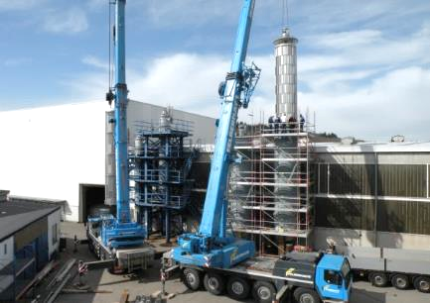
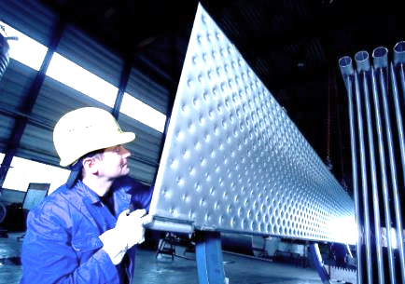
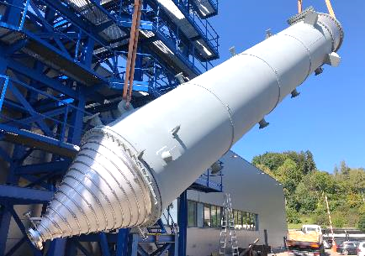
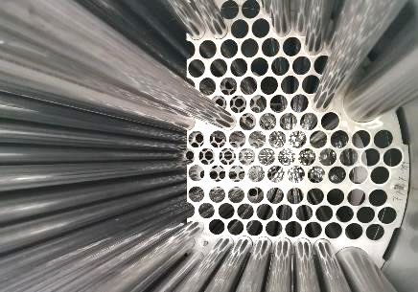
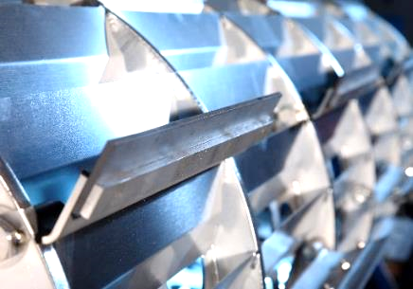
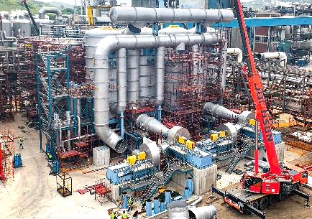
Served industries
Pulp industry
(kraft, sulfite, dissolving)
(Bio)refinery industry
Fiber industry
Alternative fuel industry
Chemical industry
(Bio)plastic industry
Food and feed industry
Processing of industrial wastewater
Carbon-intensive industries

Slide 18








Our scope of services
Consulting and studies
  Pre-engineering
  Expansion concepts /
  energy optimization
  Trouble shooting
Technical center and R&D
    Laboratory tests
    Pilot tests
    Scale up concepts
Greenfield and brownfield
Optimization and modernization
    Revamping / Retrofitting
    Debottlenecking
ENGINEERING
MANUFACTURING
& PROCUREMENT
SUPERVISION & INSTALLATION
COMMISSIONING, START-UP & TRAINING
ALL PROJECT SIZES
(pilot plant, skid unit to turnkey projects)
AFTER SALES SERVICE
PROJECT MANAGEMENT & CONTROLLING
QUALITY, HEALTH
& SAFETY

Slide 19
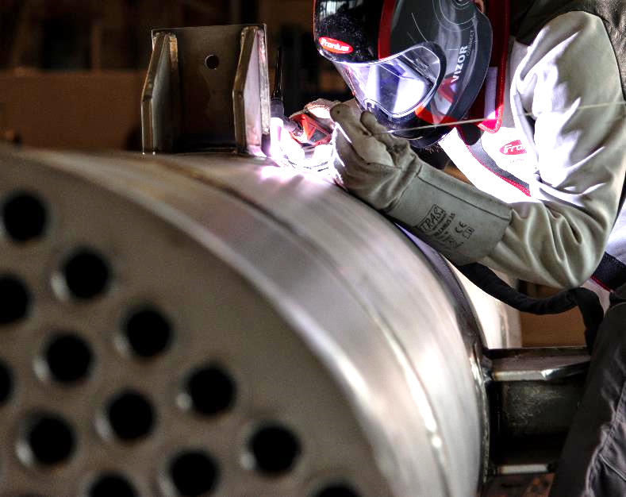
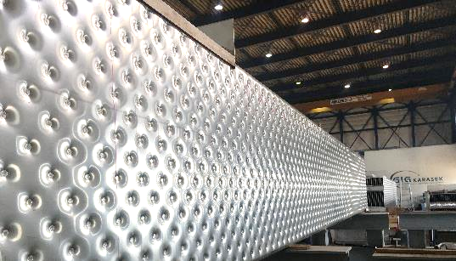
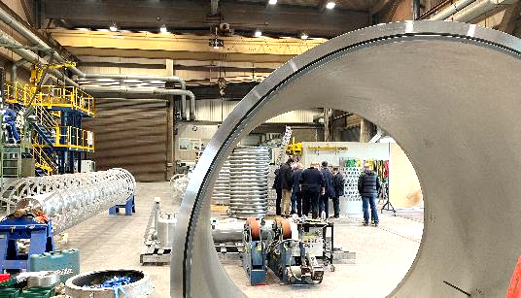
workshops – equipment made in Austria
In Gloggnitz
Focus on plate and tube falling-film evaporators
In Attnang-Puchheim
Focus on rotating evaporators
Workshop capacity:
80,000 man-hours per year
Own WORKSHOPS
in Austria, plus a global network of qualified
sub suppliers

Slide 20
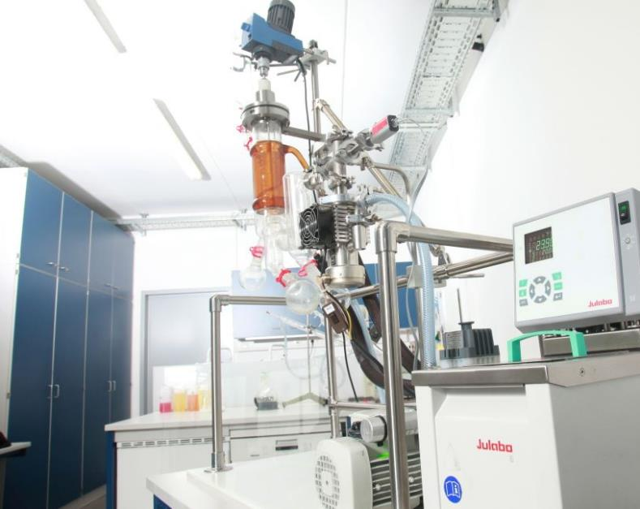
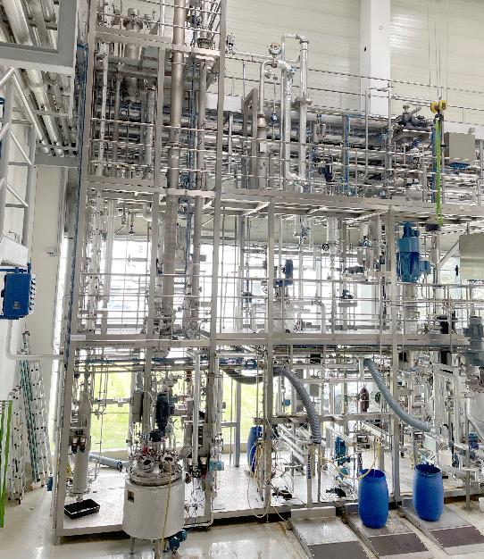
Since 2008 – Technical center
High-quality test infrastructure for customized trials
Laboratory evaporator
Thin-film evaporator
Short-path evaporator
Horizontal thin-film dryer
High-viscous evaporator
Falling-film evaporator
CO₂ valorization equipment
Own TECHNICAL CENTER
for testing, scale up and R&D

Slide 21
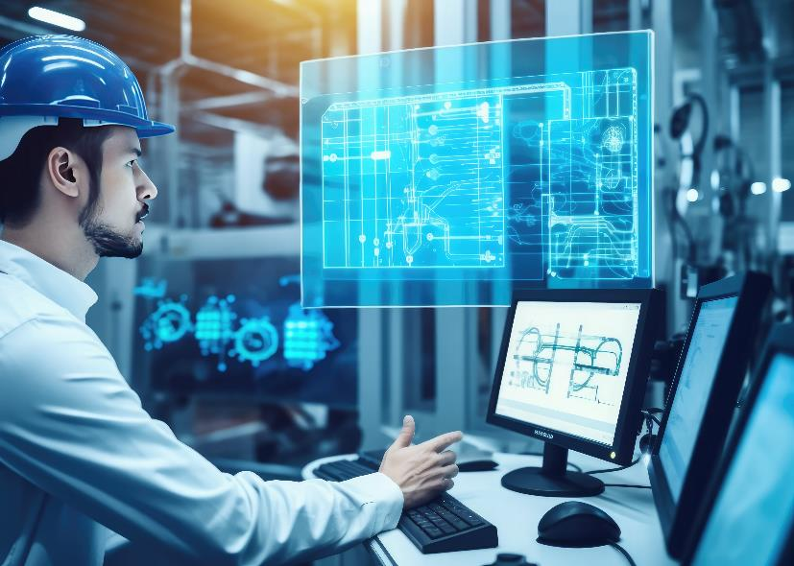
Industrial Internet of Things (IIoT)
Using the high potential of industry 4.0
Focus on the optimum point of plant operation
with the GIG Karasek Digitalization Platform
Perfectly suited for optimization of single machines, stand-alone systems or complete plants
Our Smart Services:
Digital Twin
Conditioning Monitoring
Predictive Maintenance
Optimization as a Service
For more flexibility in financing:
Pay per Use
Equipment as a Service (EaaS)

Slide 22




Interested to learn more?
Read our Technical Blog!
We‘ve posted articles and whitepapers about following applications/topics:
Sulfite liquor
Biodiesel
CO₂ utilization
Lecithin
Case studies… More to come!
TO THE BLOG

