Slide 1
CompriVAP On the way to decarbonisation with waste heat utilisation on an industrial scale

Slide 2
GIG Karasek – Who we are
Globally acting, Austrian supplier of thermal separation and environmental technology
Our offering
Core competence: Design and manufacturing of falling-film, thin-film, short-path, distillation and drying technology
Technology for CO₂ valorization and industrial heat pump solution
Projects ranging from pilot plants and skid units to turnkey plants on EPC basis
Own technical center for trials and R&D
Our motto “Concentrating the Essentials” perfectly fits to our approach and way of working. We are focusing on utmost efficiency – both, in our core competences but also in new environmental technologies.”
Andreas Schnitzhofer, General Manager
We are proud on our extensive knowhow, top-quality technology and highly committed employees. We have everything in our hands for supporting our customers and being a valued industry partner.”
Julia Aichhorn, General Manager

Slide 3
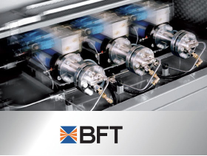
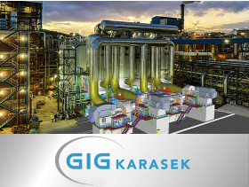
Dr. Aichhorn group
Worldwide manufacturer and provider of high-pressure equipment and high-pressure components for the chemical and petrochemical industries
European producer of high-pressure pumps with operating pressures between 200 and 1,200 Mpa
Globally acting, Austrian supplier of thermal separation and environmental technology
The Dr. Aichhorn Forestry Estate is sustainably managed according to the latest forestry knowledge available

Slide 4
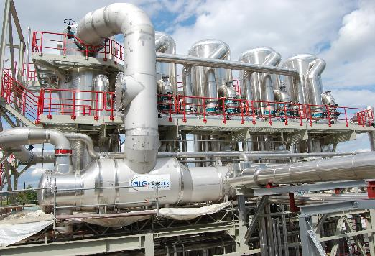
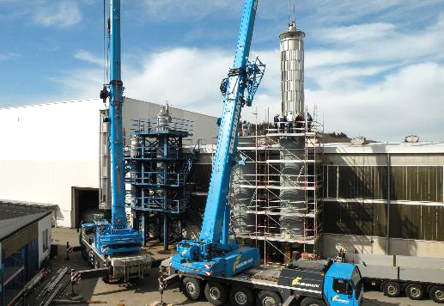
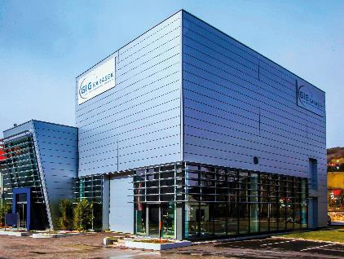
GIG Karasek – Our business units
Conventional Evaporation Technology
Different types of evaporators and tailor-made process solutions for
high evaporation rates
Thin-film and Short-path Technology
Different types of evaporators for complex tasks and tailored process solutions
Environmental Technologies
CO₂ valorization and industrial heat pump technology for a sustainable economy
Technical Center
Laboratory tests, pilot test and scale up concepts for thermal separation and environmental technologies

Slide 5
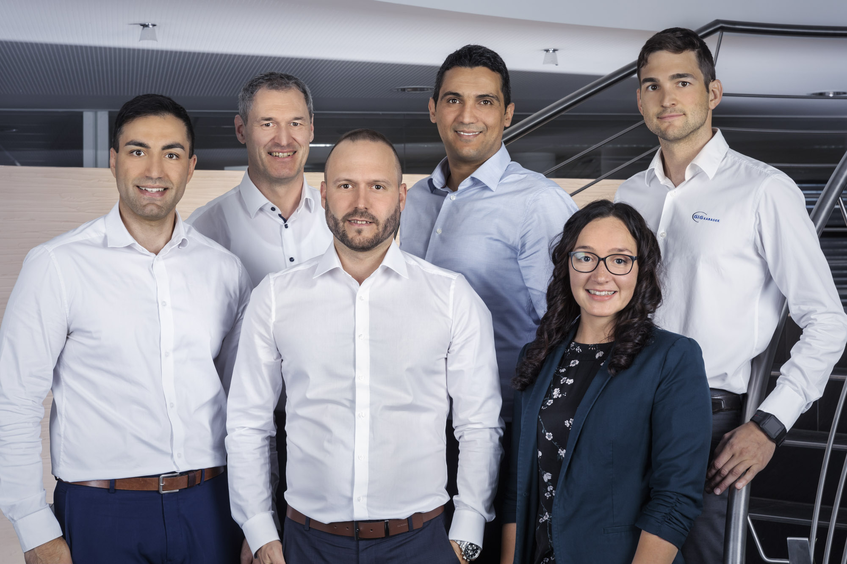
Environmental Technologies
New business unit established in 2022
Focusing on
DEFOSSILIZATION
CO₂ valorization = transformation of carbon dioxide into chemicals and fuels
DECARBONIZATION
Waste heat utilization by means of CompriVAP industrial heat pump solution
GIG Karasek Team Environmental Technologies?

Slide 6
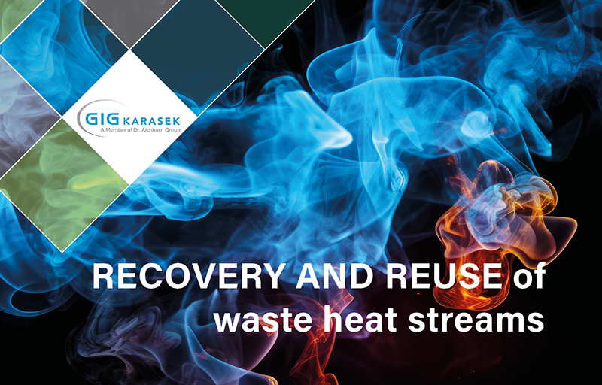
unused waste heat in industry
Present problem
Exhaust steam and wastewater are typical waste heat streams
Largely not reused, although a significant amount of energy is still contained
Furthermore, cooling down/additional energy input is needed for environmental release
Renewable Energy Directive (RED III-EU/22023/2413)
§22a Mainstreaming renewable energy in industry
… Waste Heat can be included under conditions …

Slide 7
NEED FOR WASTE HEAT UTILISATION
WHY WASTE HEAT UTILIZATION?
Reuse waste heat
→ Reduction of primary energy demand
→ Significant reduction of CO₂ emissions possible
Economic use of resources
→ less fresh steam and cooling water demand
High potential of OPEX savings

Slide 8
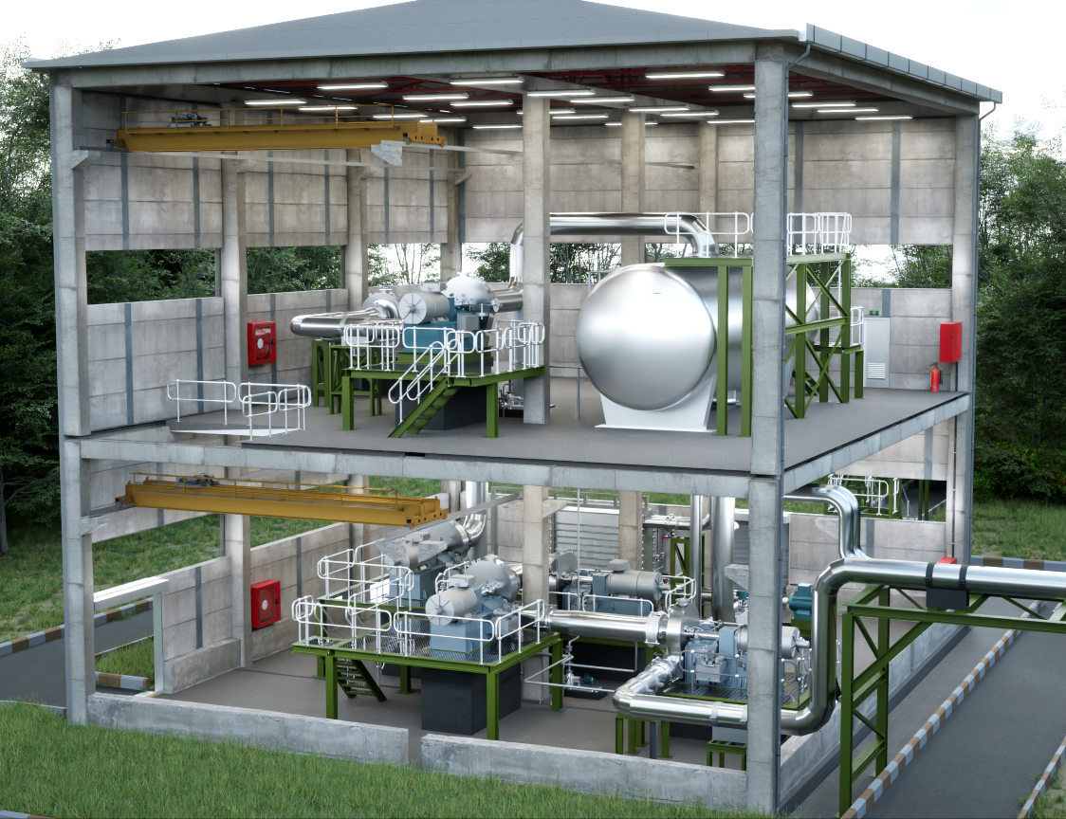
A solution
Steam generation by industrial waste heat utilization

Slide 9
CompriVAP Industrial heat Pump Solution
Example: Industrial heat pump solution with Piller compressors
MAIN FUNCTIONAL PRINCIPLE
Energy level of steam is raised by means of MVR (Mechanical Vapor Recompression) fans
Preconditions:
Sufficient low-pressure input medium available
Possible input: waste steam or warm liquid
Clearly defined output target
© Piller

Slide 10
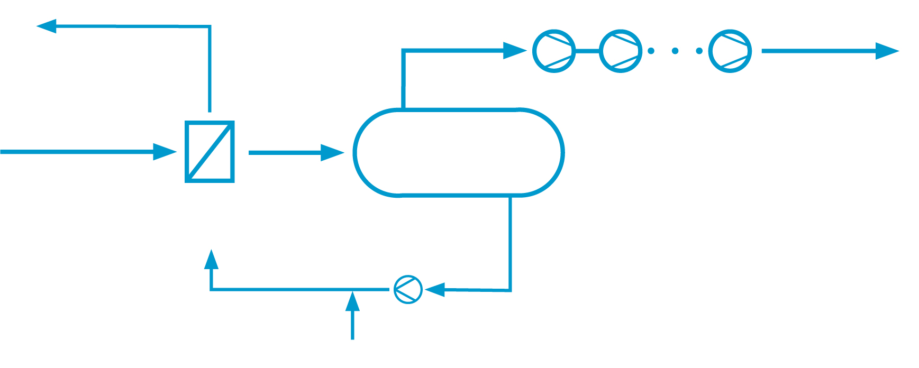
CompriVAP Industrial heat Pump Solution
RECROMPRESSION FANS driven by green energy
RETURN
TO HEAT CONSUMER
OR STEAM NET
OUTPUT STEAM
SOURCE
VACUUM FLASH TANK
Warm liquids or vapours
OPTIONAL Secondary media circuit working with demineralized water only
HEAT EXCHANGER
Residual water
Condensate return (e.g. closed media loop) or Make up water

Slide 11
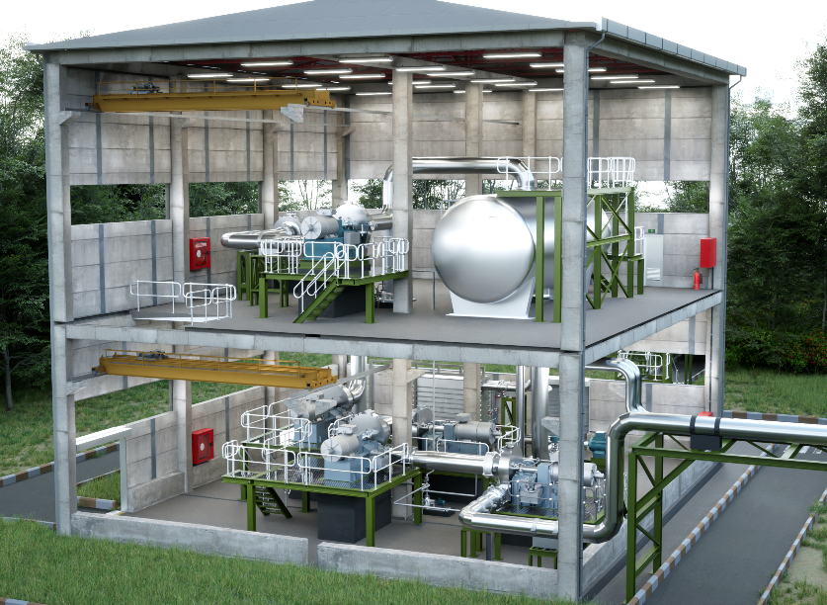
Thermodynamically favorable conditions
THERMODYNAMICALLY FAVORABLE CONDITIONS
Energy sources:
Residual or surplus process vapors
Hot water or other warm liquids
Steam generation:
up to 215°C and 20 bar(g) possible
Compressor setup serial and / or parallel
No refrigerants used (!)
> 70 °C
2
1
3
2
1
Flash tank
2
Compressors
3
Heat exchanger

Slide 12
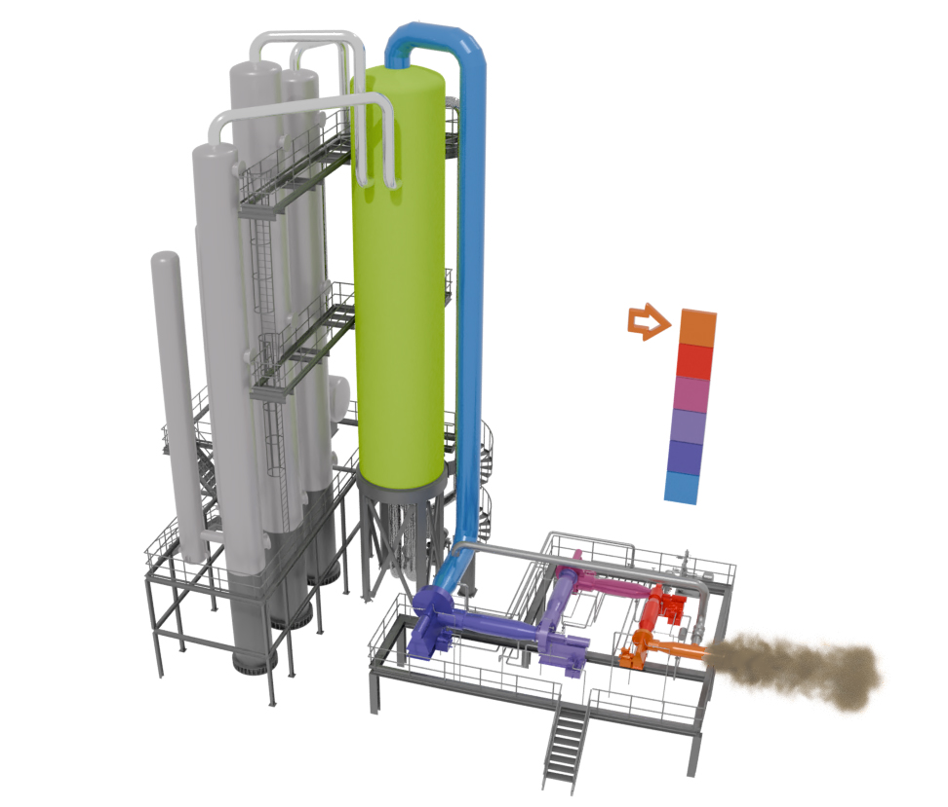
Solution for Multiple Energy Sources
One single heat exchanger for multiple heat recovery

Slide 13
Use Case - Heat Recovery Dryer Application (Small)

Slide 14
Engineered application Dryer (SMALL)
MULTIPLE VAPOR RECROMPRESSION
REUSE as process steam for internal heating
Vacuum steam
OUTPUT STEAM
RETURN
Warm water
> 2.600 kg/h
Steam duty > 1,56 MW up to 4,1 bara ~ 144°C
INPUT
VACUUM FLASH TANK
Heat source: Warm water 72°C
Approx. 1,3 MW thermal power
HEAT EXCHANGER
REQUIREMENTS
Reuse of warm water at >72°C
Thermal Power available at Input side approx. 1,3 MW
Generate process steam for an internal heating application
Make available >2500 kg/h steam at >144 °C saturated (4,1 bara)
Continuous operation over 350 days/a
Turn down ratio to <70%
Residual water
Makeup water

Slide 15
Engineered application Dryer (SMALL)
PROPOSED SOLUTION
9-stage CompriVAP system (Skid)
Layout on 2 levels to fit in existing brown field area
Solution with vacuum flash tank
Operation in partial-load possible (turn down ratio: <70%)
System is controlled by VSDs of the compressor motors
COP (shaft): >3,6
KEY PARAMETERS
Total installed electrical power: | 450 kW
Total operating power: | 416 kW
Total steam output (design value): | 2.600 kg/h
Discharge temp. saturated | 144 °C
Discharge pressure | 4132 mbar(a)

Slide 16
Use Case - Heat Recovery Pulp Mill (Medium)

Slide 17
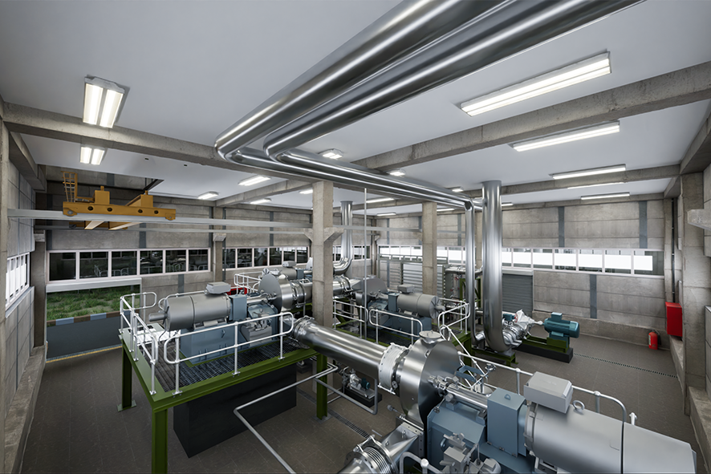
Engineered application Pulp mill (medium)
CUSTOMER REQUIREMENTS
Reuse of warm water at 78°C
Generate process steam for an internal heating application
Make available 15,1 MW LP steam at 3,5 bara and 139 °C saturated
Continuous operation over 350 days/a
Turn down ratio to 70%

Slide 18
Engineered application Pulp mill (medium)
MULTIPLE VAPOR RECROMPRESSION FANS
REUSE as process steam for internal heating
OUTPUT STEAM
INPUT
VACUUM FLASH TANK
up to 3,5 bara at ~ 139°C
Heat source: Warm water 78°C
HEAT EXCHANGER
Residual water
PROPOSED SCOPE OF SUPPLY
Engineering and design, procurement, delivery, installation, commissioning and start-up
Makeup water

Slide 19
Engineered application Pulp mill (medium)
PROPOSED SOLUTION FOR USE CASE – 3,5 BAR
6-stage CompriVAP system
Layout on 2 levels to fit in existing brown field area
Solution with vacuum flash tank
Operation in partial-load possible (turn down ratio: 35%)
System is controlled by VSDs of the compressor motors
KEY PARAMETERS
Total installed electrical power: | 4,80 MW
Total operating power: | 4,07 MW
Total steam output (design value): | 25.333 kg/h
Discharge temp. saturated | 138,9 °C
Discharge pressure | 3504 mbar(a)

Slide 20
Engineered application Pulp mill (medium)
OPEX COMPARISON COSTS LIFE STEAM VS. ELECTRICITY
 |  | EXAMPLE 1 | EXAMPLE 2
Operation time | h/a | 8000 | 8000
Price LP steam* | EUR/t | 40 | 60
Costs/a LP steam | EUR/a | 8 106 560,00 | 12 159 840,00
Price electricity* | EUR/kWh | 0,1 | 0,1
Costs/a electricity | EUR/a | 3 252 715,79 | 3 252 715,79
Potential savings | EUR/a | 4 853 844,21 | 8 907 124,21
Potential savings | EUR/3a | 14 561 532,63 | 26 721 372,63
COP COEFFICIENT OF PERFORMANCE
Massflow | Kg/h incl. injection | 25 333,0
Power shaft | kW | 3 862,6
Motor eff | % | 95,0
Electrical power | kW | 4065,9
Latent heat | kJ/kg at 3,37 bara | 2147,7
 | COP | 3,72
* Estimation depending on client conditions

Slide 21
Use Case – Heat Recovery Industrial Application (Large)

Slide 22
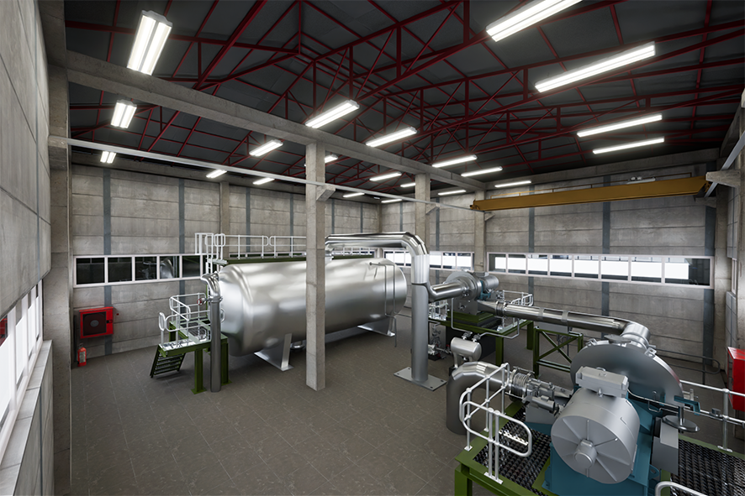
Engineered Industrial application (large)
REQUIREMENTS
Reuse of warm water (>1500 t/h, @>72°C ) to generate process steam for the MP Steam line
Make available >60 t/h steam @ >5,5 bara
Use the CompriVAP process to increase the steam output pressure up to 6 bara saturated steam

Slide 23
Engineered Industrial application (large)
MULTIPLE VAPOR RECROMPRESSION FANS
Return
Vacuum steam
Feed into factory steam line or individual use
Warm water
OUTPUT STEAM
Input
VACUUM FLASH TANK
>60 t/h incl. injection water
up to 6 bara saturated steam
>35 MW steam duty and more possible
Warm water up to 72°C, 1500 t/h
HEAT EXCHANGER
Residual water
PROPOSED SCOPE OF SUPPLY
Engineering and design, procurement, delivery, installation, commissioning and start-up
Makeup water

Slide 24
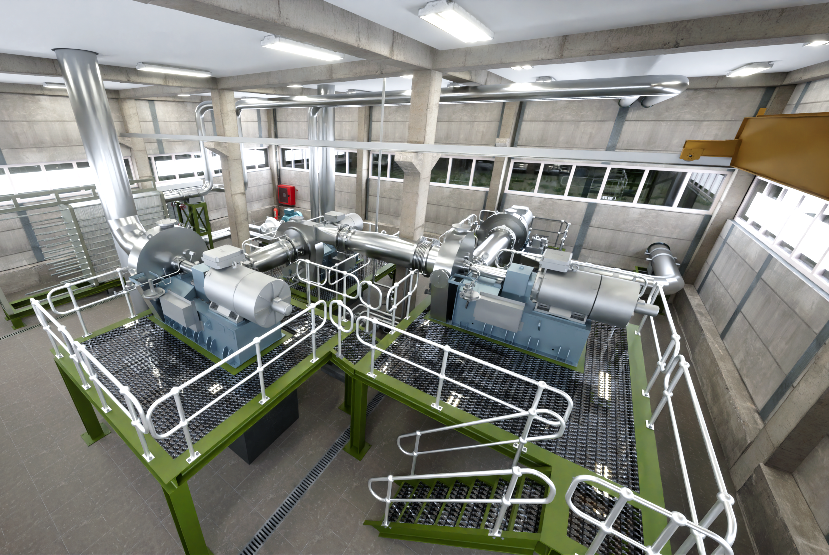
use case – Industrial application (large)
PROPOSED SOLUTION FOR USE CASE
11-stage CompriVAP system
Layout on 1 level
Solution with vacuum flash tank
Operation in partial-load via bypass (turn down 50%)
System is controlled by VSDs of the compressor motors
COP >3,3 possible

Slide 25
A common project

Slide 26
CompriVAP Industrial heat Pump Solution
HOW WE SUPPORT YOU
Detailed evaluation of available waste heat
Tailored process design comprising open or partly open process circuits
Careful selection of compressors from different OEMs
Detailed planning of necessary compression stages
Fact-based evaluation of CAPEX and OPEX aspects

Slide 27
CompriVAP Industrial heat Pump Solution
SCOPE OF SUPPLY: TURNKEY
Process design
Basic- and Detail engineering
Compressors, auxiliary equipment, spare parts
Vapor ducts and piping
Flash tank (if needed)
Instrumentation
Installation and supervision
Commissioning and startup support

Slide 28
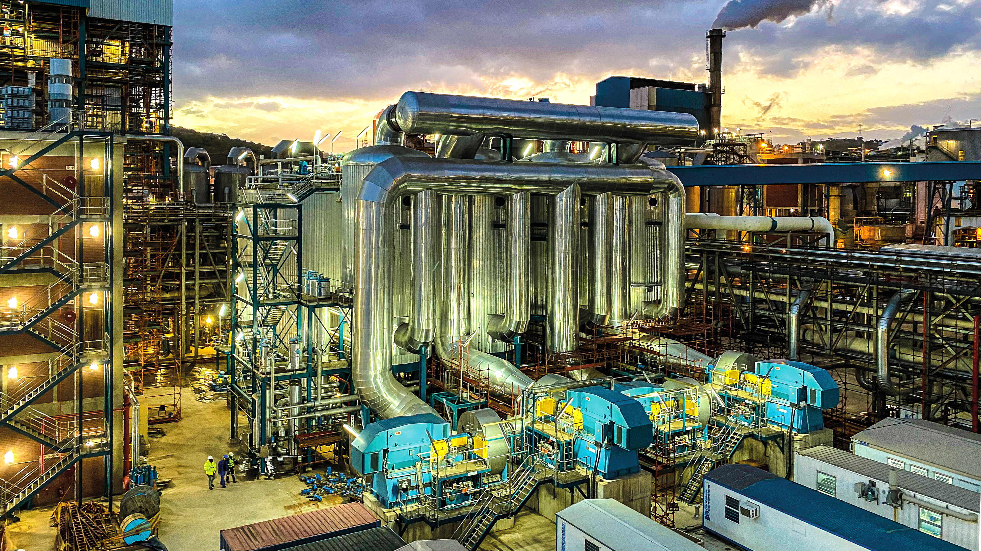
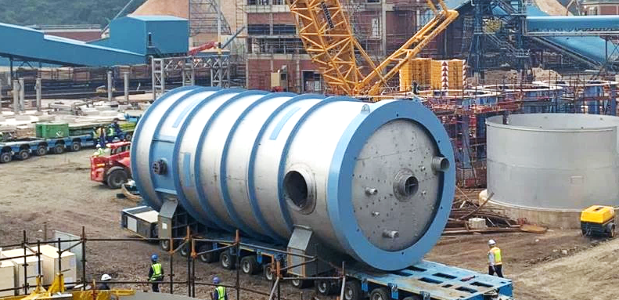
Reference highlight – MVR technology
SAPPI SAICCOR, South Africa
Application | Sulphite spent liquor
Scope | 300 t/h water evaporation 16 MW installed power
HIGHLIGHT | Largest MVR evaporation plant for sulphite liquor EPC delivery: MVR plant and tank farm (2018-2021)

Slide 29
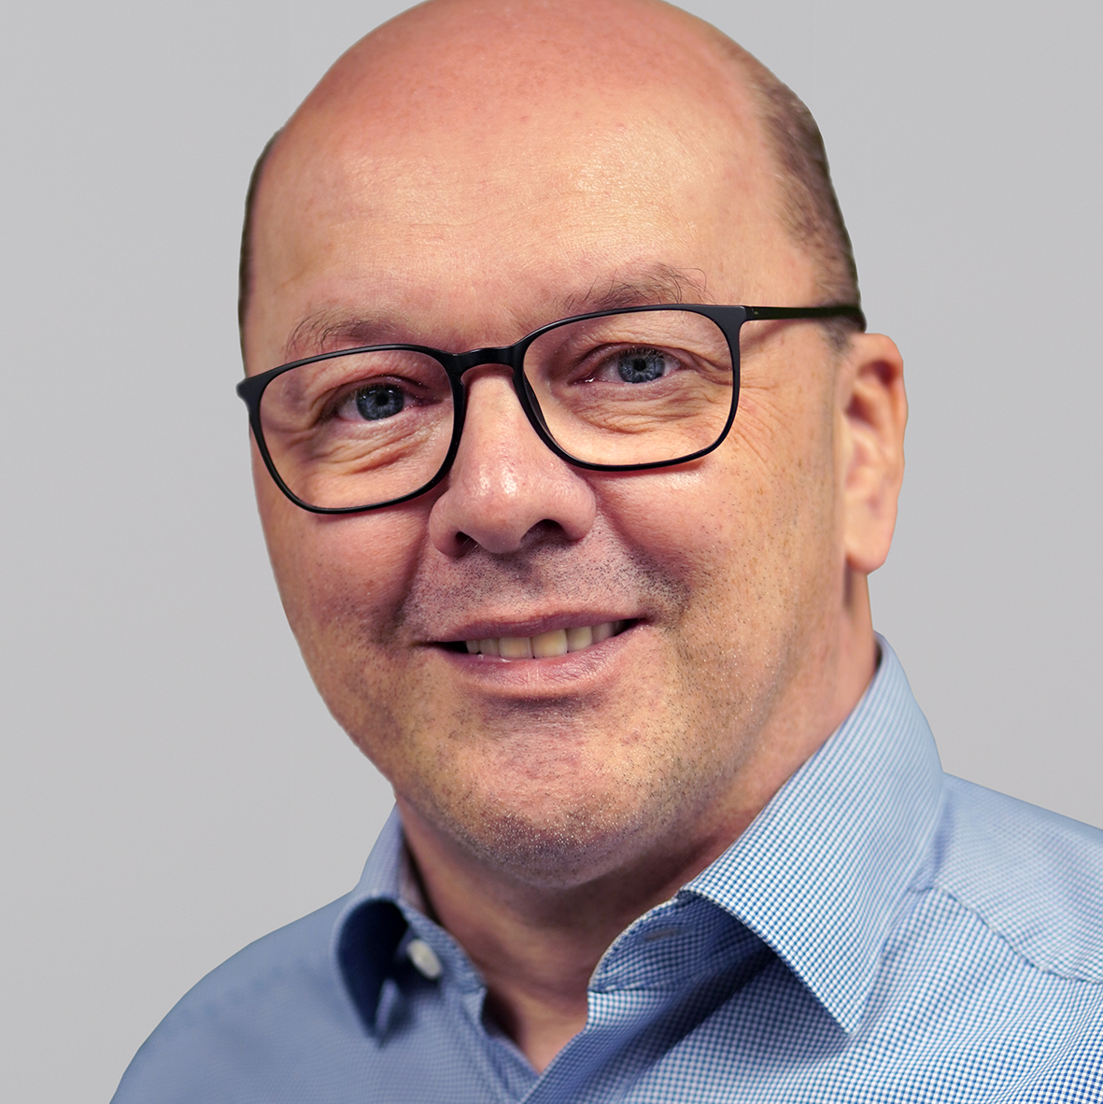
Josef Grassauer
+43 664 8218703
j.grassauer@gigkarasek.at

