Slide 1
Lamella Technology POWER Spot and LASER Luxe Lamellas

Slide 2
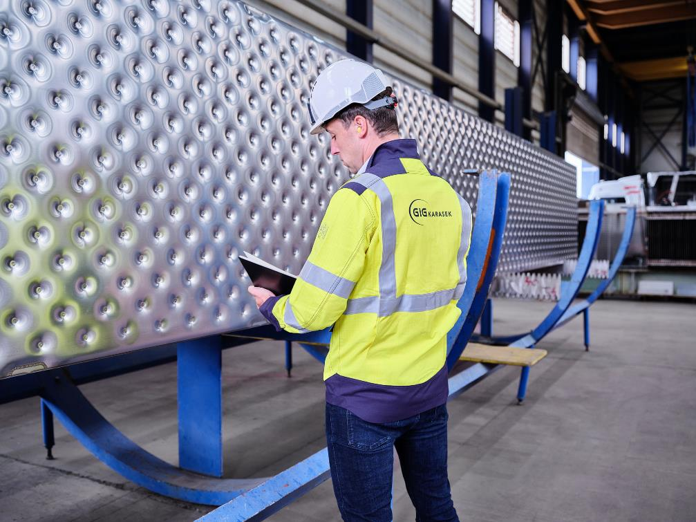
Everything from a single source
GIG Karasek supplies different…
Lamella formats
Materials
Welding processes
Our core competence for decades: Production of falling-film evaporators
Made-in-Austria quality Production in our inhouse lamella production facility

Slide 3
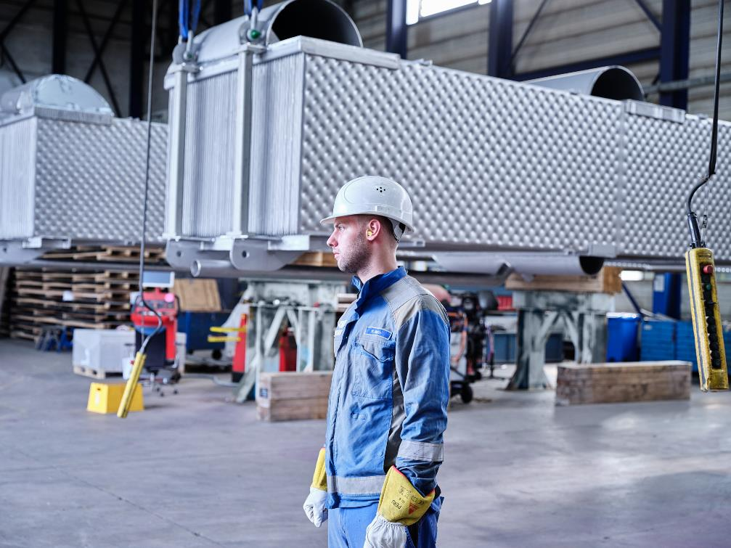
POWER Spot and LASER Luxe lamellas
POWER Spot = spot-welded lamellas
LASER Luxe = laser-welded lamellas
Both types feature long lifetime, minimal risk of fouling and corrosion thanks to…
…plate forming process developed by GIG Karasek
…fully closed edge welding

Slide 4
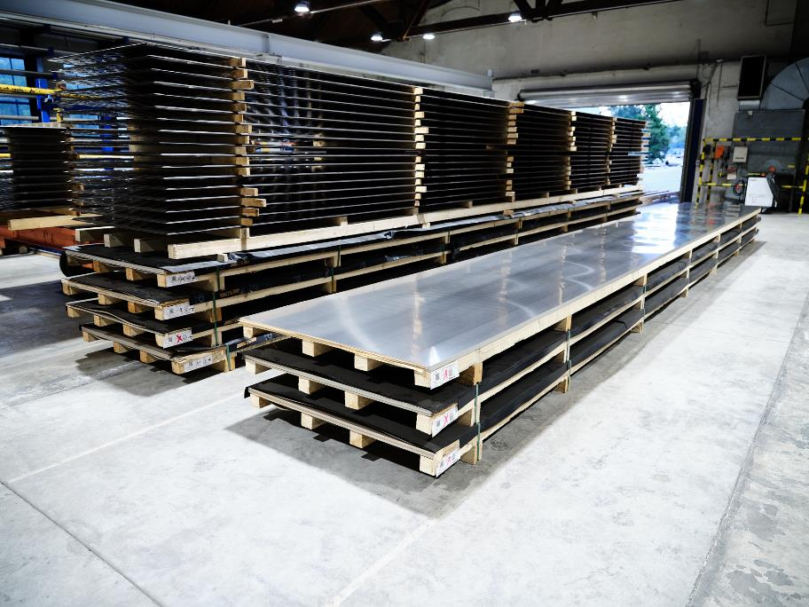
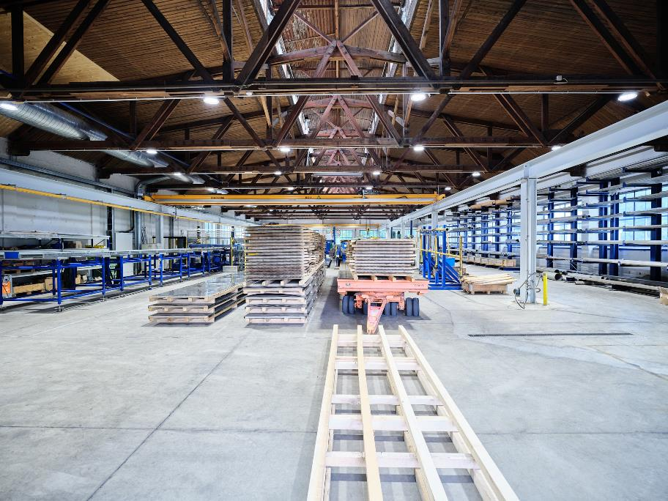
Lamella Production – inhouse production

Slide 5
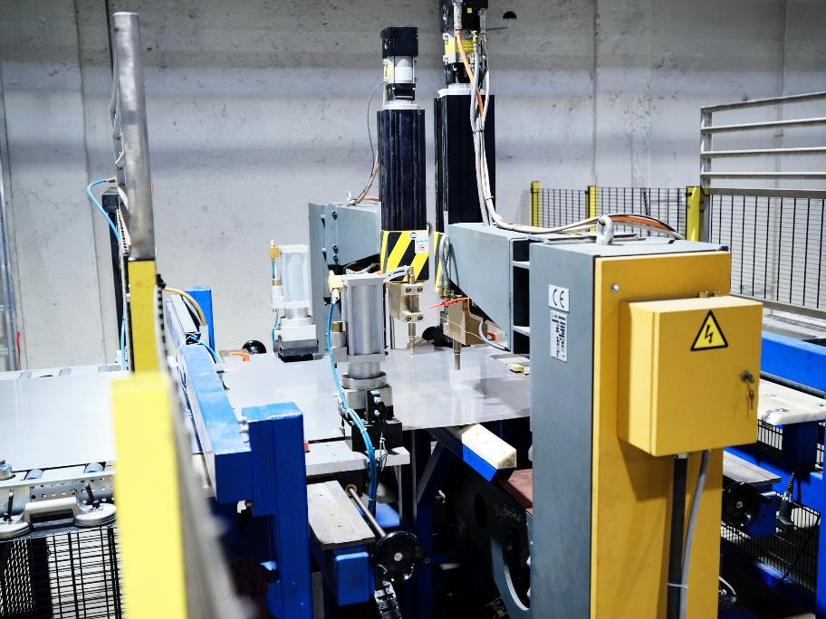
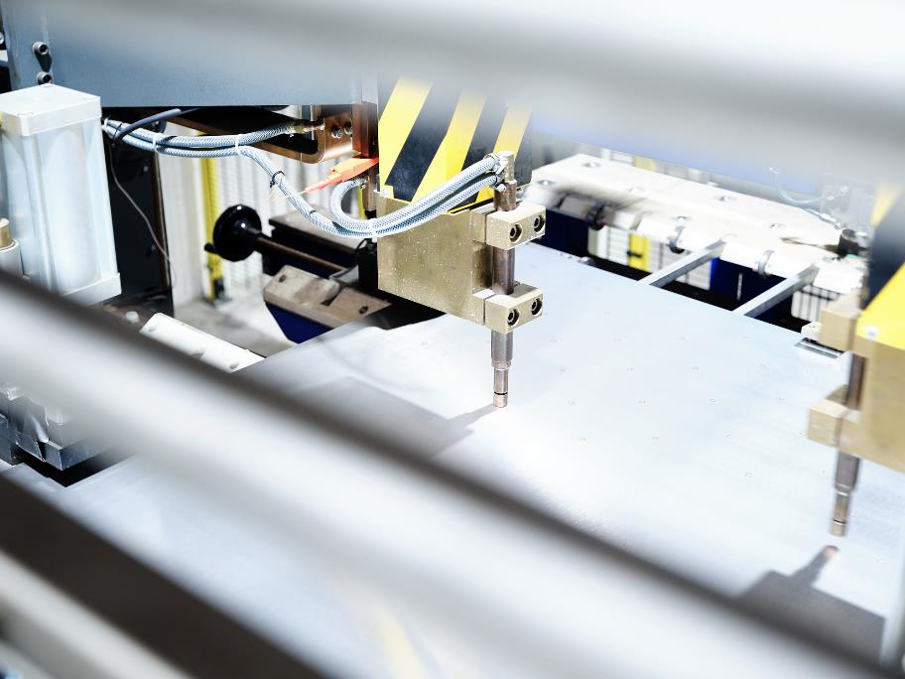
Lamella Production – inhouse production

Slide 6
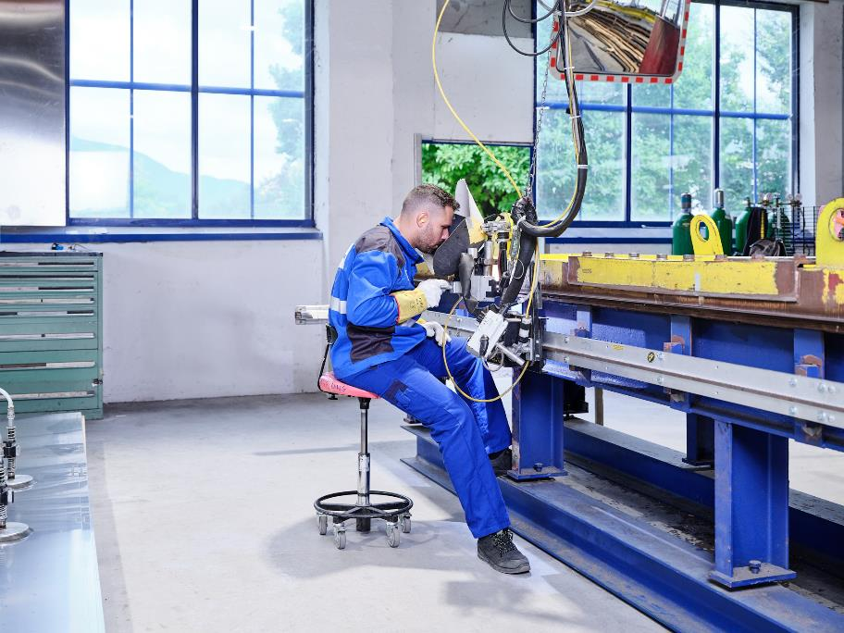
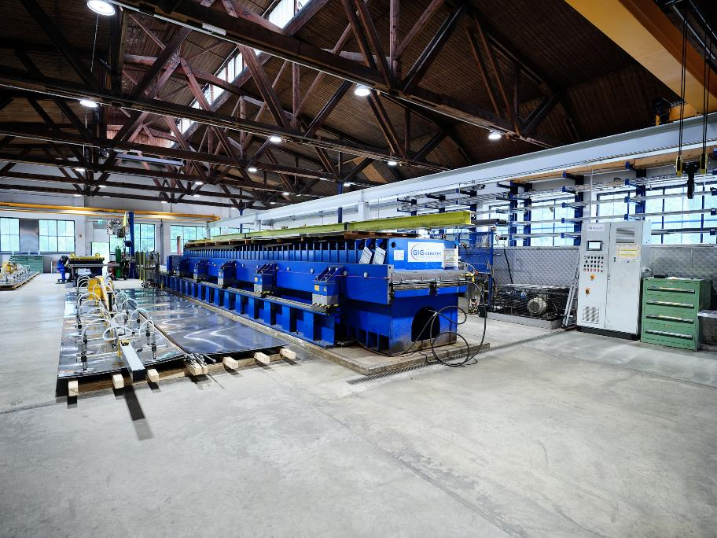
Lamella Production – inhouse production

Slide 7
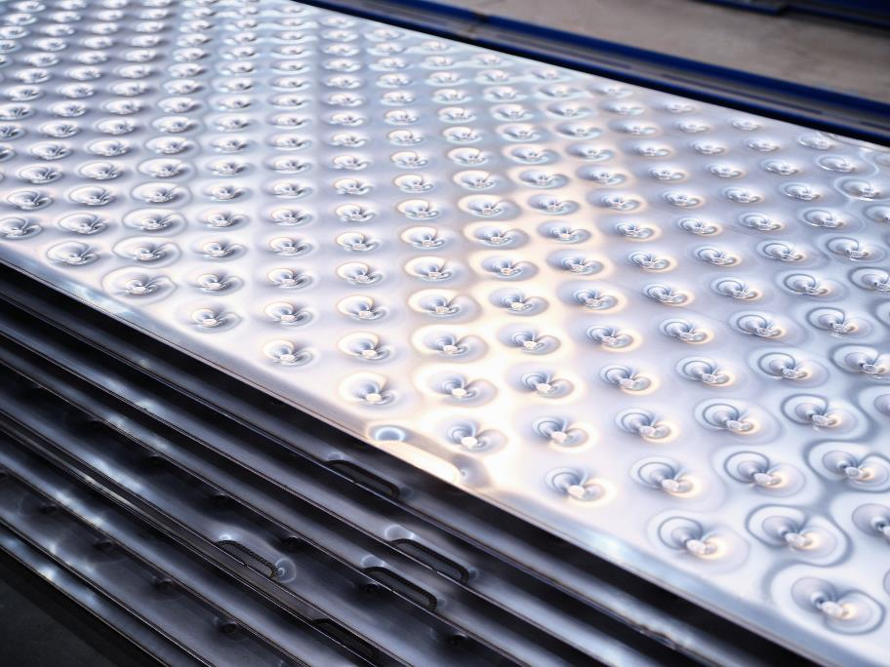
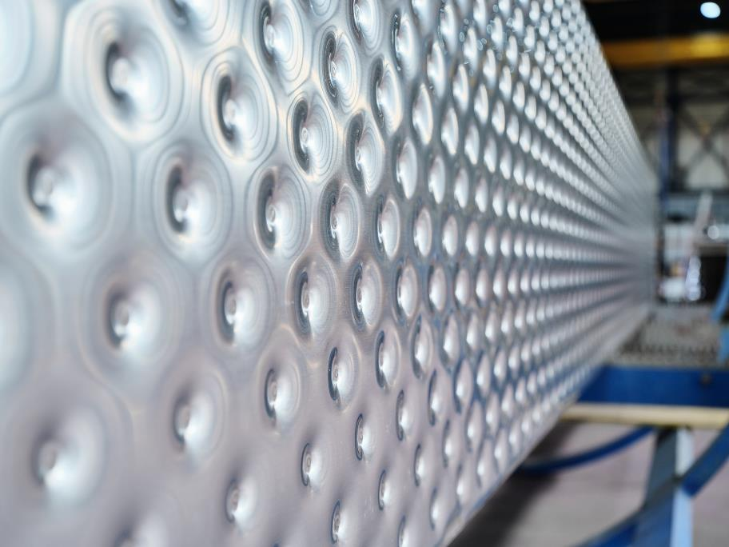
Lamella Production – inhouse production

Slide 8
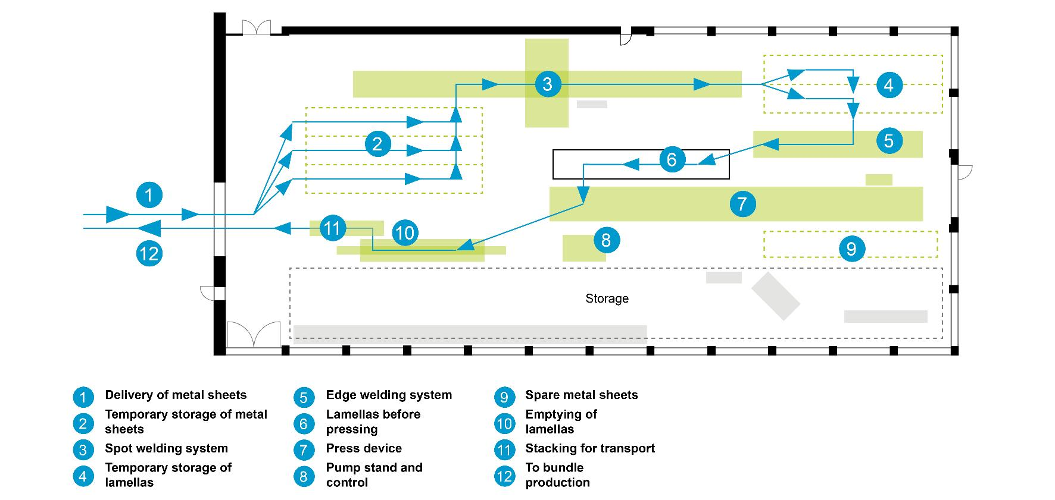
Lamella Production – inhouse production

Slide 9
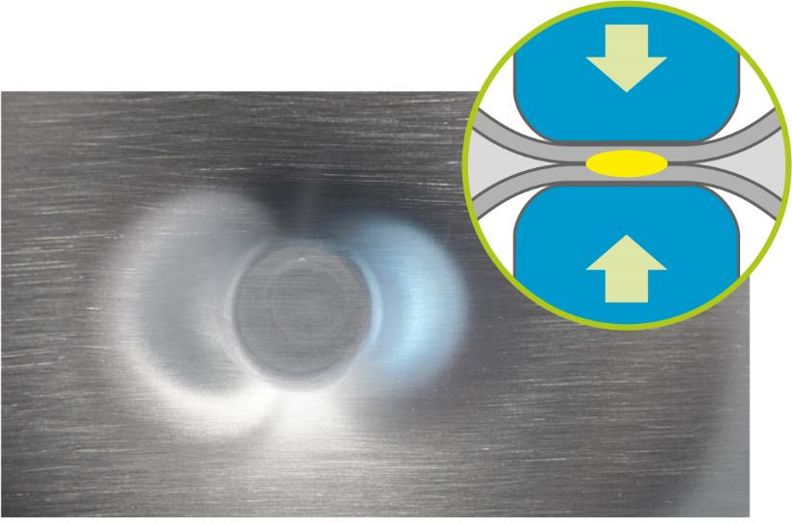
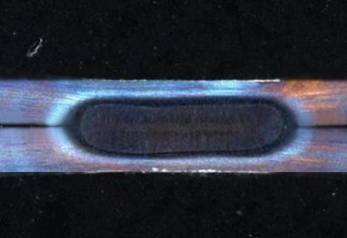
Power Spot – spot-welded lamella
Smooth plate surfaces minimizes risk of fouling and corrosion
Material properties remain unchanged at the spot-welding surface reducing the risk of corrosion
No stress in welding spot due to holding down during inflation of the plates
Low pressure drop due to maximum widening heights between plates (also with DUPLEX Steel)
Solid, durable and closed edge welding resulting in minimum risk of corrosion at the edges → Extreme long lifetimes, low risk of fouling and corrosion, outstanding quality

Slide 10
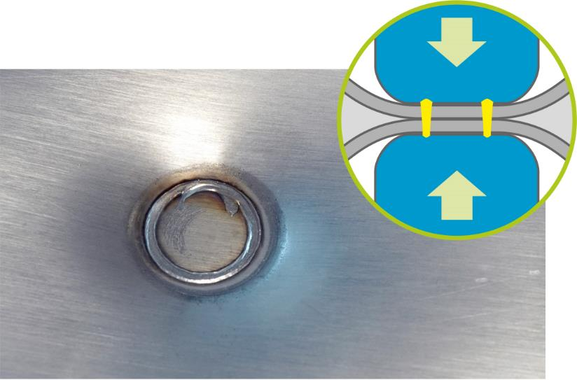
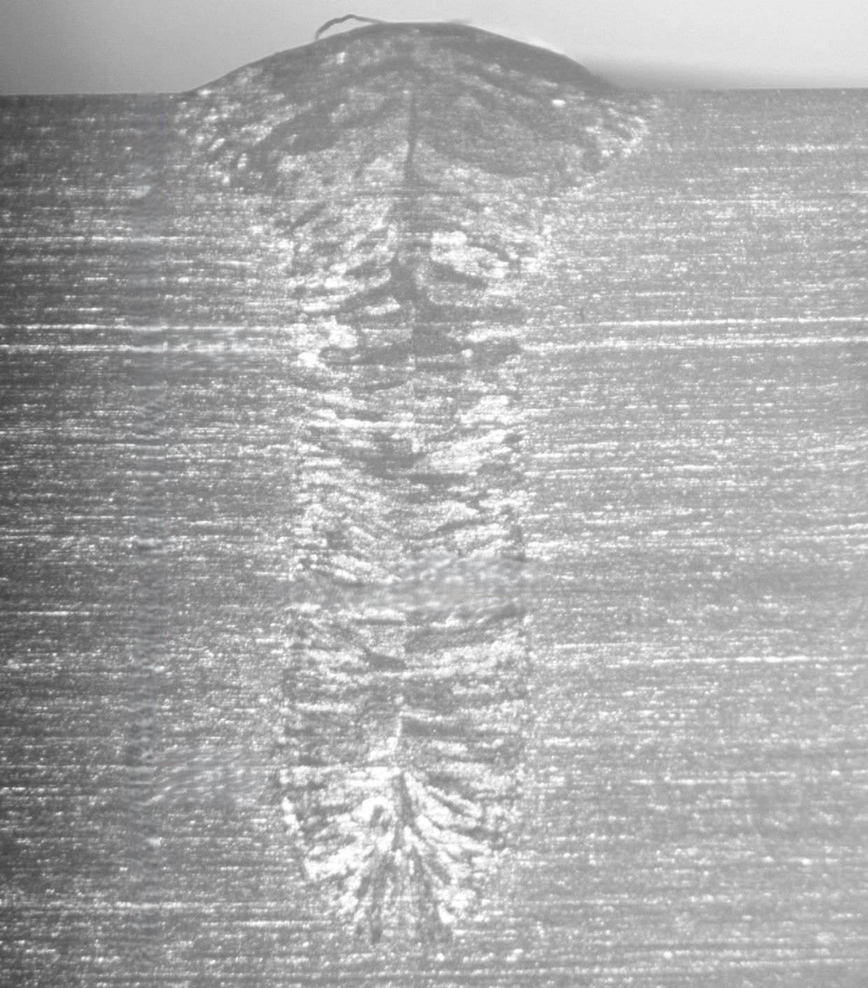
LASER LuXE – Laser-welded lamella
Strong and highly durable laser welding as pillow plate weldings
Highest resistance against bursting due to latest laser welding technique
No stress in laser welding due to holding down during inflation of the plates
Low pressure drop due to maximum widening heights between plates (also with DUPLEX Steel)
Solid, durable and closed edge welding resulting in minimum risk of corrosion at the edges.
→ Extreme long lifetimes, low risk of fouling and corrosion, outstanding quality

Slide 11
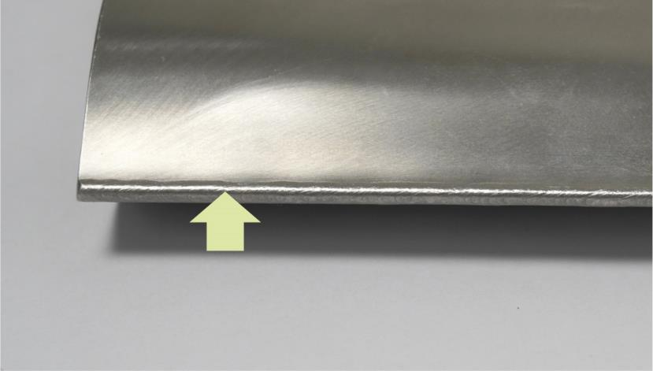
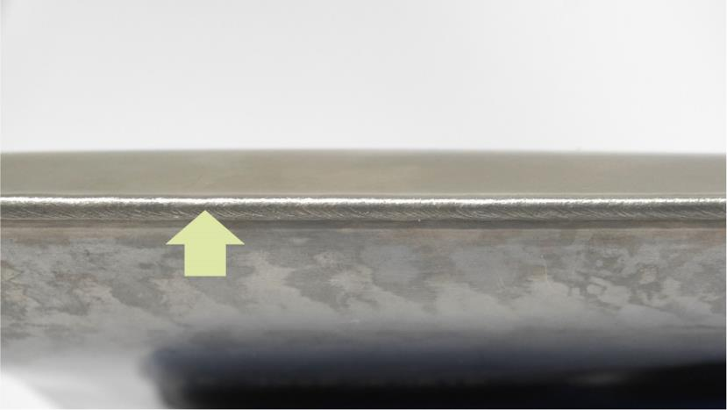
edge welding - Power Spot & Laser Luxe
Continuous edge welding for POWER Spot and LASER Luxe Lamellas

Slide 12
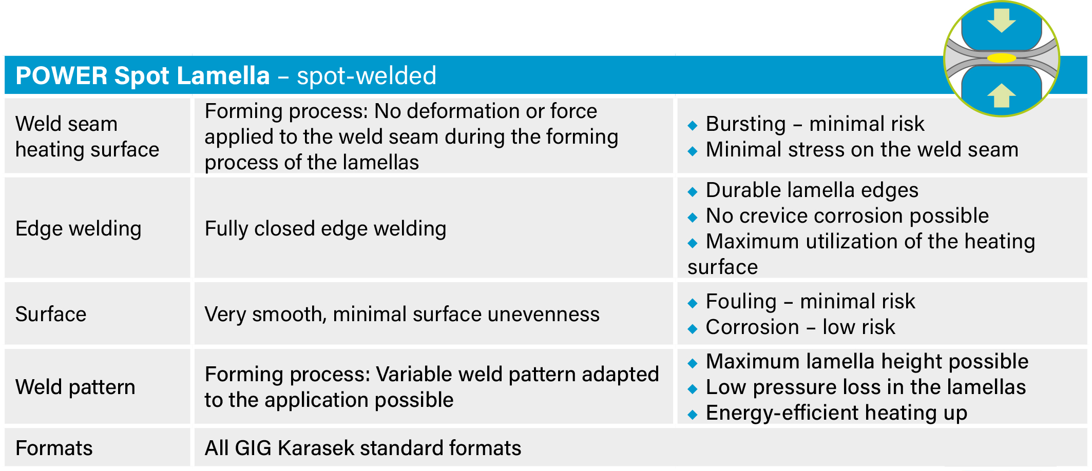
Lamellas in comparison

Slide 13
Lamellas in comparison

Slide 14
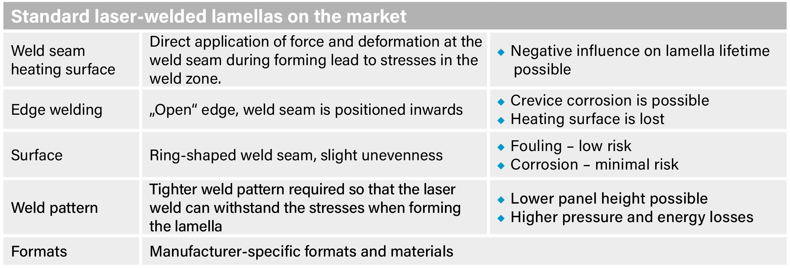
Lamellas in comparison

Slide 15
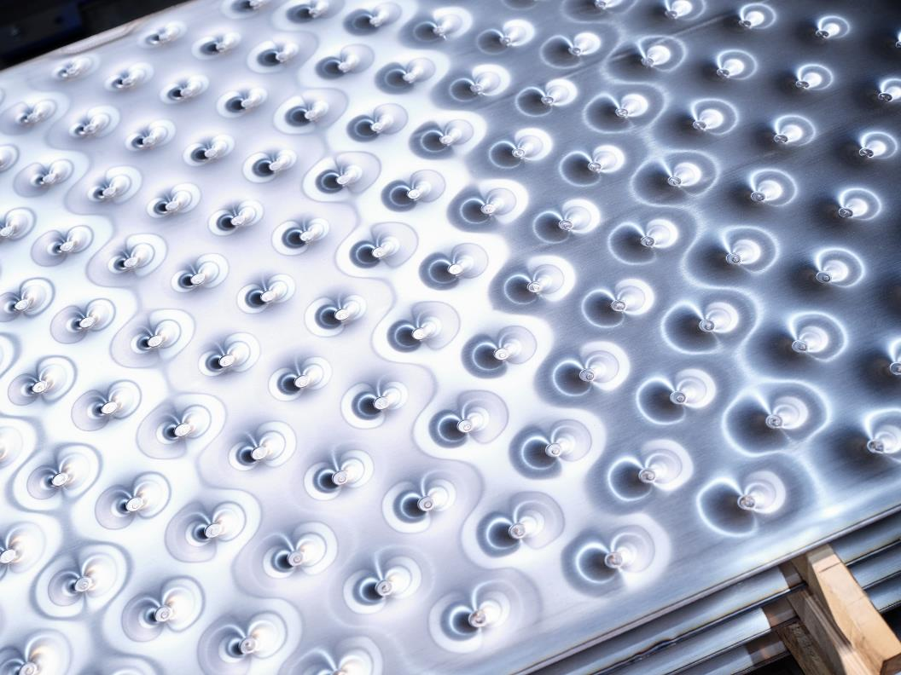
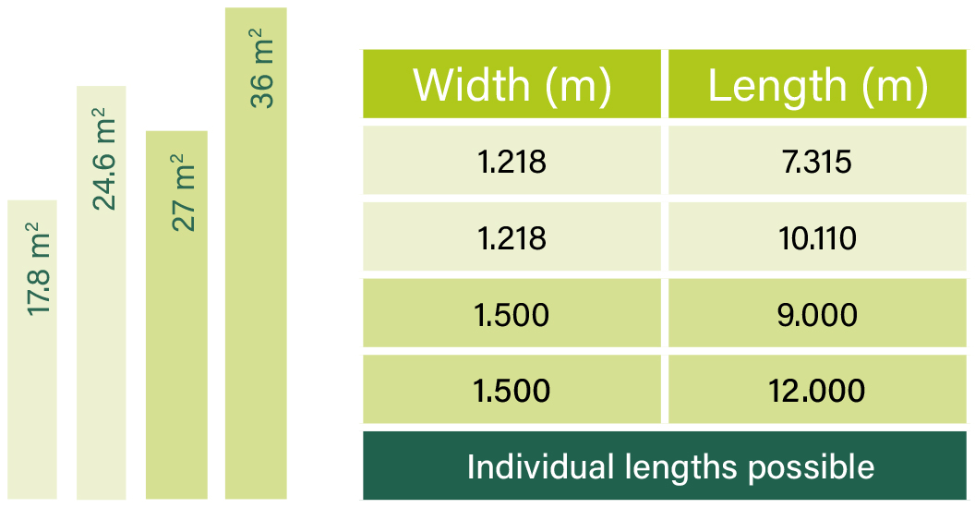
GIG Karasek Lamella Formats

Slide 16
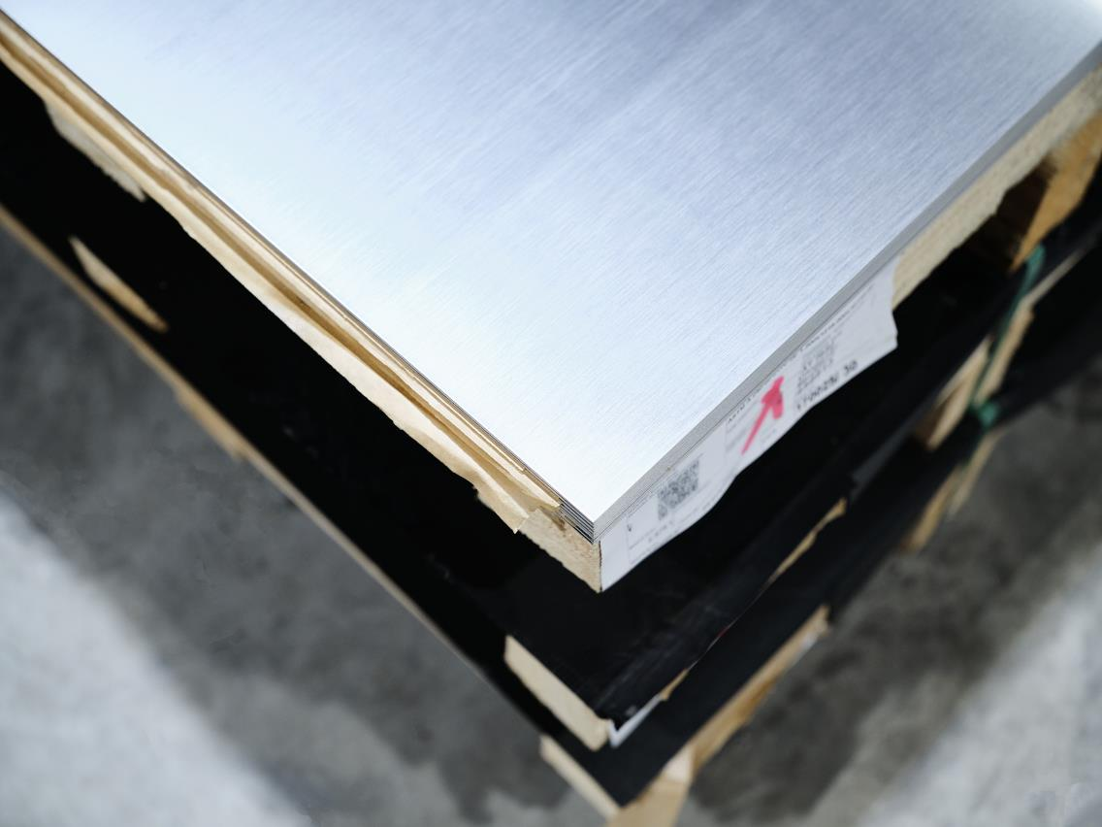
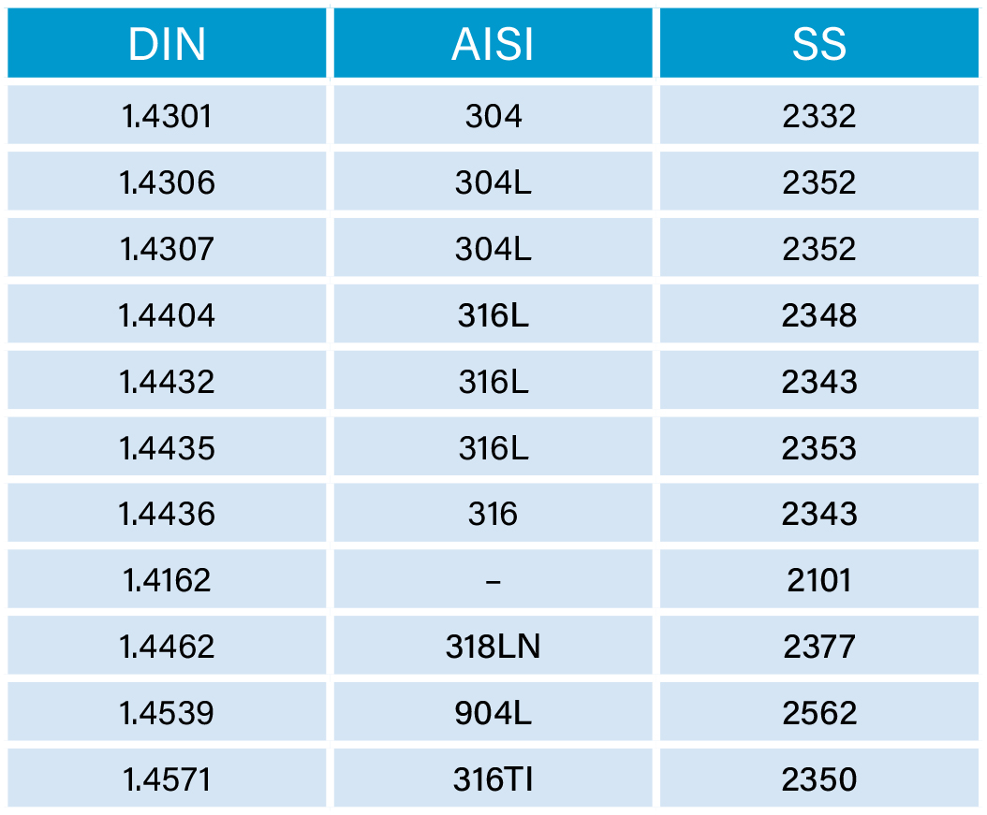
Lamella Materials

Slide 17
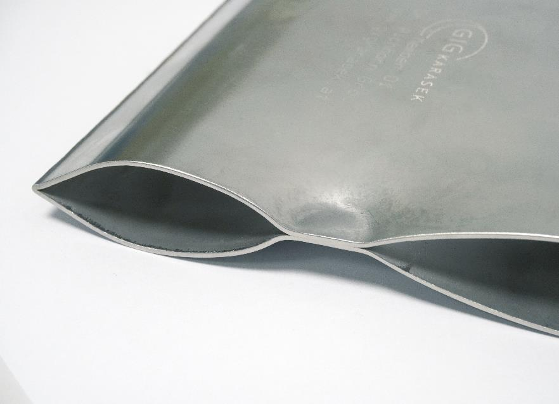
Advantages at a glance
Flexibility in terms of formats, materials, welding processes and customer specific requirements
Minimal risk of fouling
Minimal risk of corrosion
Long lifetime
No stress or deformation of the weld seams during production
Robust edge welding
Optimum utilization of heating surface
Optimized spot- and laser-welding lamellas

Slide 18
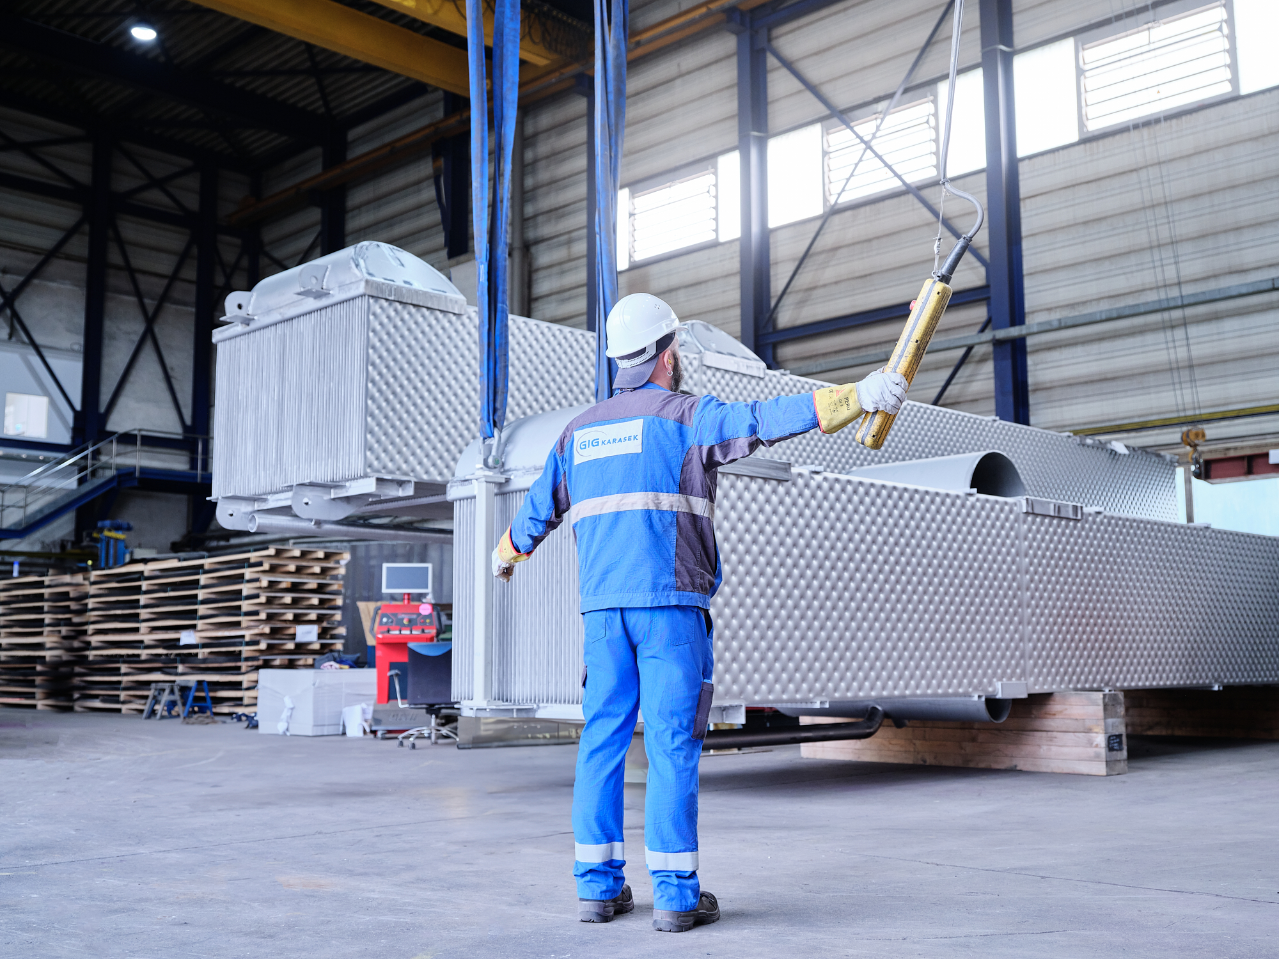
Bundle production – step by step
Lamellas are welded to a bundle with the help of distance profiles
Welding of steam inlets and condensate collectors
Production of distribution trays and accessories
Certified pressure test
Pickling and passivation of the bundles
Packaging, transportation & documents
Complete documentation

Slide 19
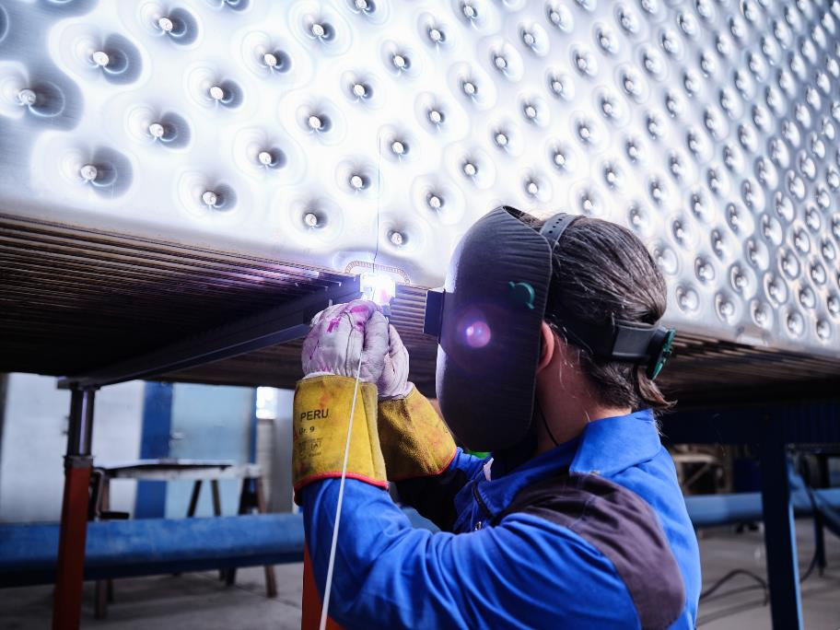
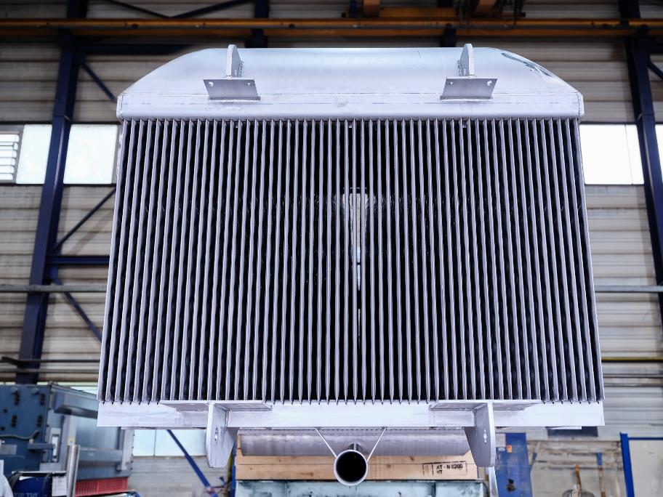
Bundle production

Slide 20
Quality assurance
Weld spots | Lamellas | Bundle
Automatic electronic documentation of the welding parameters for each welding spot Failure report when tolerance values are exceeded Additional visual inspection | Pressure test for each lamella Burst pressure test of each production series | Pressure test for each bundle, if required under external supervision (notified body) Pressure or leakage test after installation according to customer requirements

Slide 21
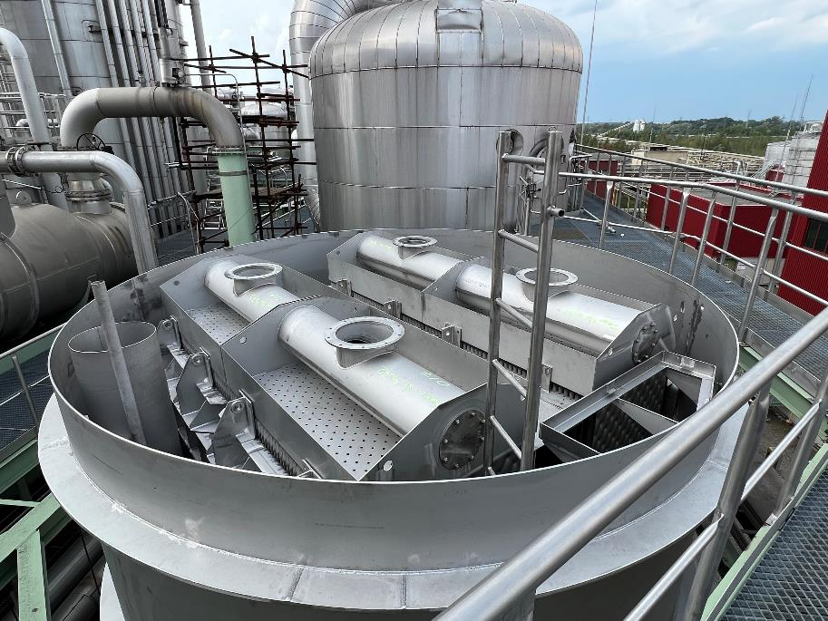
Bundle replacement
Retrofitting
End-of-life bundles are replaced with new bundles
Unchanged: system conditions, plate dimensions and evaporation surface
Modernization in the shortest possible downtimes
Modernization at the lowest possible cost

Slide 22
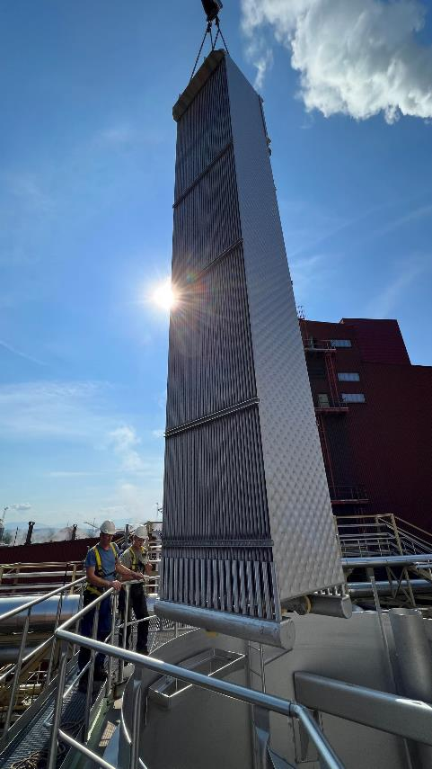
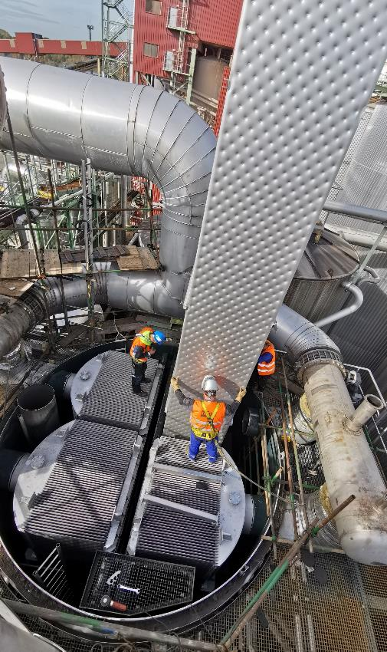
Bundle replacement
Debottlenecking
More extensive measures
Targeted examination and elimination of problem areas in the process
Replacement of end-of-life bundles
Redimensioning of evaporation surface area
Investment still significantly smaller than new system
Downtimes as short as possible

Slide 23
How to Increase Evaporation Capacity
Evaporation capacity is mainly increased by adding heating surface area to an evaporator
.
1:1 Replacement | Increase height | Decrease pitch | Increase height and decrease pitch
Same capacity | Width stays the same, height increases e.g. 1.219 x 7.315 → 1.219 x 10.110 mm or 1.500 x 9.000 mm → 1.500 x 12.000 mm ~30% more heating surface area | Putting more lamellas into one row e.g. decrease pitch from 40 to 35 mm ~15% more heating surface area | Combination of both ~ 50% more heating surface area
In any case a check and potential redesign is needed of following items: Vapor ducts, size of droplet separators, circulation pump and piping, transfer pumps, statics of the effect and foundation, etc.

Slide 24
The Bundle Replacement
Support on an EPC package delivery
Bundle design and constructional drawings
Inhouse fabrication
Bundle delivery on Site
Shutdown preparation and pre-assembly
Shutdown activities
Dismantling of effect
Bundle lifting and reinstallation of new bundle
Revamping of the effect
Pressure test and quality control
Mechanical supervision and daily protocol
Installation service and sub-supplier coordination
Documentation and after sales service
Out of one hand, no interfaces
Fast and uncomplicated shutdown service
Reliable partner with dozens of references

